Slide 1
How to Use This Pharm4Me Presentation
Welcome!
This pre-made pharmacy presentation is designed to introduce middle school students to the world of pharmacy in a fun and simple way. It covers key topics like what pharmacists do, where they work, and how they help people stay healthy.
Feel free to customize the slides however you’d like! You can add personal stories, adjust the language to fit your students' level, or include interactive activities to make the lesson more engaging. This presentation is just a starting point—make it your own to best fit your teaching style and audience!
Enjoy sharing the exciting world of pharmacy with your students!
Sincerely,
AACP Staff
American Association of Colleges of Pharmacy
1400 Crystal Drive, Suite 300 ▪ Arlington, VA 22202
703.739.2330 (main)
pharm4me@aacp.org
www.aacp.org, www.pharmacyforme.org

Slide 2
Introduction to Pharmacy and Pharmacy Careers
For Middle School Kids

Slide 3
Introduce yourself…
Notes:
Hey everyone! My name is [Your Name], and today we’re diving into the world of pharmacy.

Slide 4
What do pharmacists do?
Notes:
Ask audience: What do you think pharmacists do?
[Pause for answers]

Slide 5
What do pharmacists do?
They are experts in medicine
Help keep people healthy
Ensure patients get the right medications and take them safely
Help prevent harmful side effects and drug interactions
Notes:
Pharmacists play a crucial role in healthcare by:
Dispensing medication
Pharmacists are experts in medicine and play a key role in keeping people healthy. They make sure patients get the right medications, understand how to take them safely, and avoid harmful side effects.

Slide 6
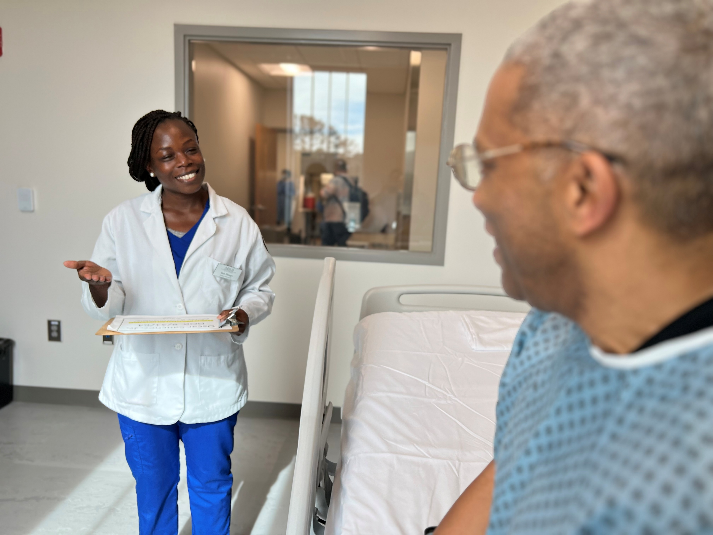
What do pharmacists do?
Pharmacists work with doctors and nurses to choose the best treatments
Did you know?
Most pharmacists work in community pharmacies and hospitals!
Bureau of Labor Statistics, U.S. Department of Labor. Pharmacists. Occupational Outlook Handbook. Updated April 3, 2024. Accessed April 4, 2025. https://www.bls.gov/ooh/healthcare/pharmacists.htm#tab-3
Notes:
Pharmacists play a crucial role in healthcare by:
Work as part of a healthcare team
Pharmacists work closely with doctors and nurses to choose the best treatments for each person.

Slide 7
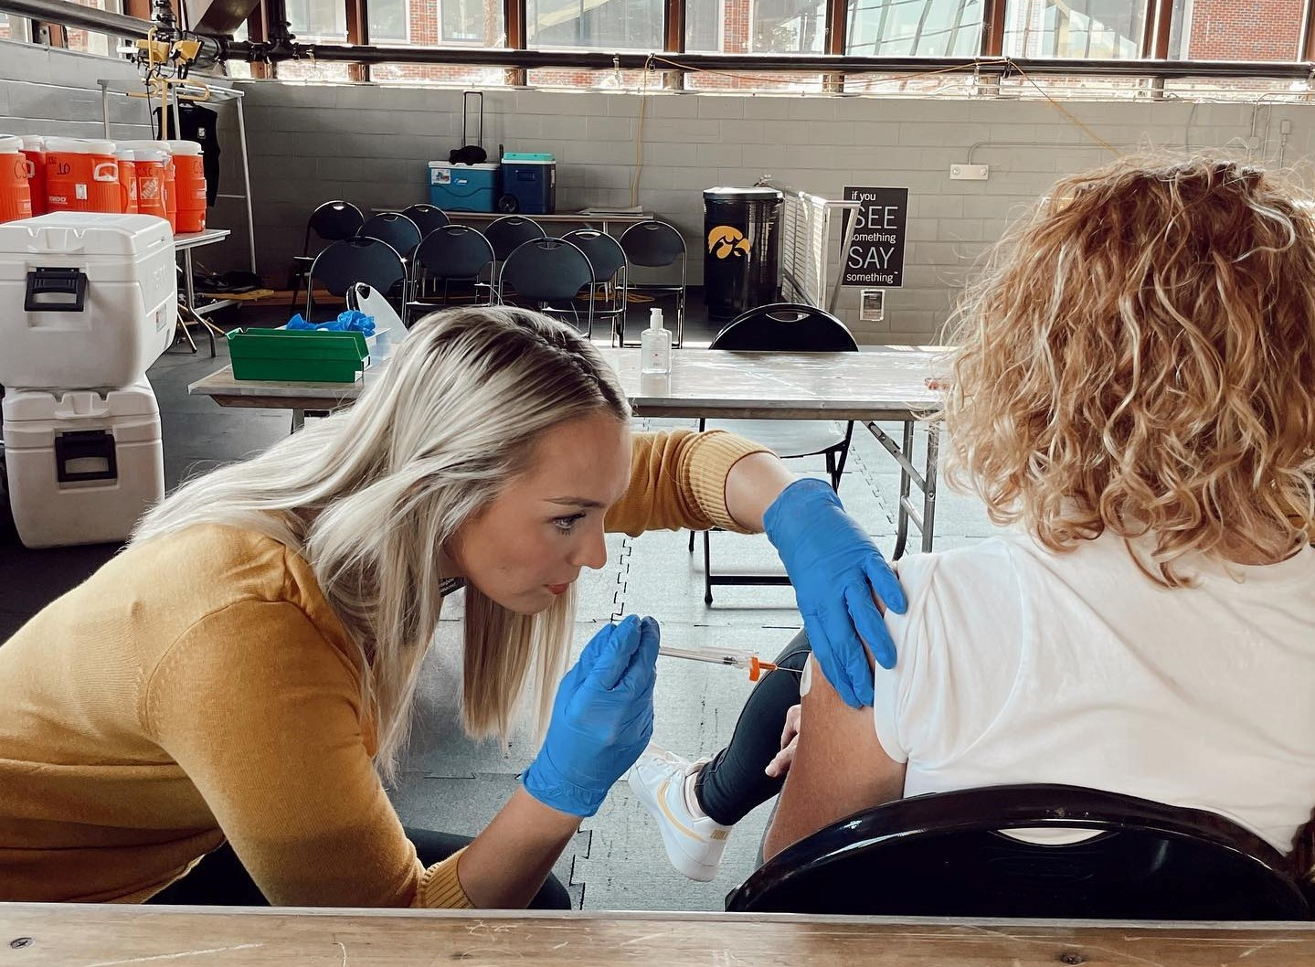
What do pharmacists do?
Research and develop new medicines
Create personalized medication plans
Promote public health (ex.: Stopping the spread of COVID-19)
Manage chronic diseases (ex.: diabetes, heart failure)
Notes:
Pharmacists play a crucial role in healthcare by:
Develop new medicines
Pharmacists might work on a research team or for a pharmaceutical company researching and developing new medicines.
Create personalized medications for patients
Some patients are taking many medications and pharmacists help make sure their patients are using medications correctly, at the correct amount, and make sure they don’t interact with other medications.
Promote public health
During the COVID-19 pandemic, pharmacists played a crucial role in keeping everyone safe by giving out vaccines, medications, and important health information. They helped patients’ symptoms get better, made sure medicine was available for everyone, and helped prevent the spread of the virus. Many pharmacies can test patients for illnesses like COVID or the Flu and prescribe medications for them to use.
Manage chronic diseases
Some pharmacists also specialize in treating diseases like diabetes, asthma, or heart disease. Often, these patients are taking many medications, and their pharmacist can help them to be on the most effective medication plan, reduce costs, and decrease side effects.

Slide 8
Pharmacists help people live better, healthier lives.
Video used with permission. American Society of Health-System Pharmacists. Your Pharmacist Video Campaign. 2025. Available at: https://www.yourpharmacist.org/

Slide 9
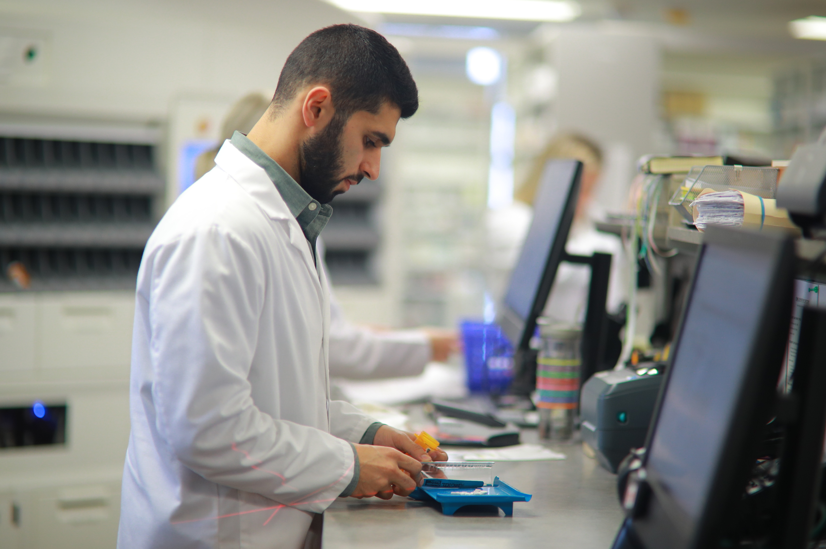
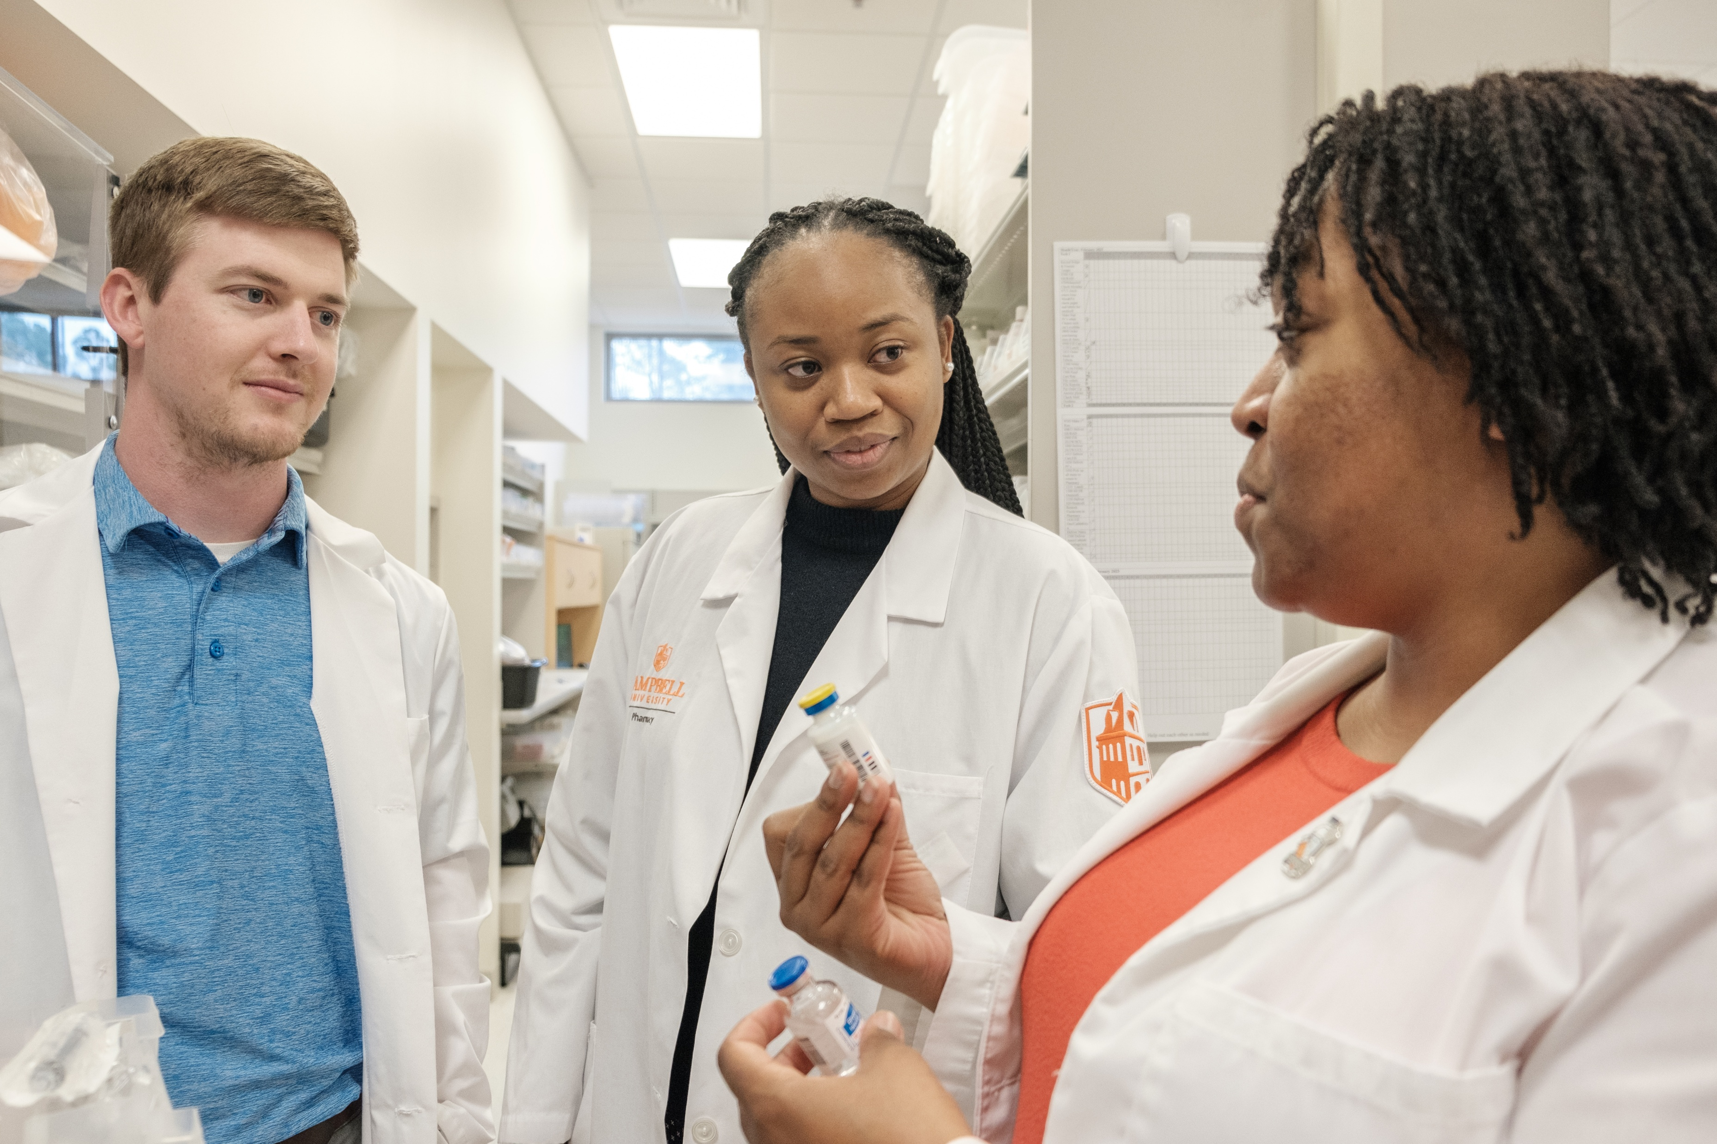
Where do Pharmacists work?
Labs
Government
Community
Hospital
Notes:
Pharmacists work in many different places. They can be found in:
Community Pharmacies (like CVS, Walgreens, or local, independent pharmacies).
Hospitals, working alongside doctors and nurses.
Research Labs, developing new medicines.
Government Agencies, ensuring medication safety.
Basically, anywhere there is a medication, there is a pharmacist!
Which of these settings do you think would be the most interesting to work in and why? [Pause for responses]

Slide 10
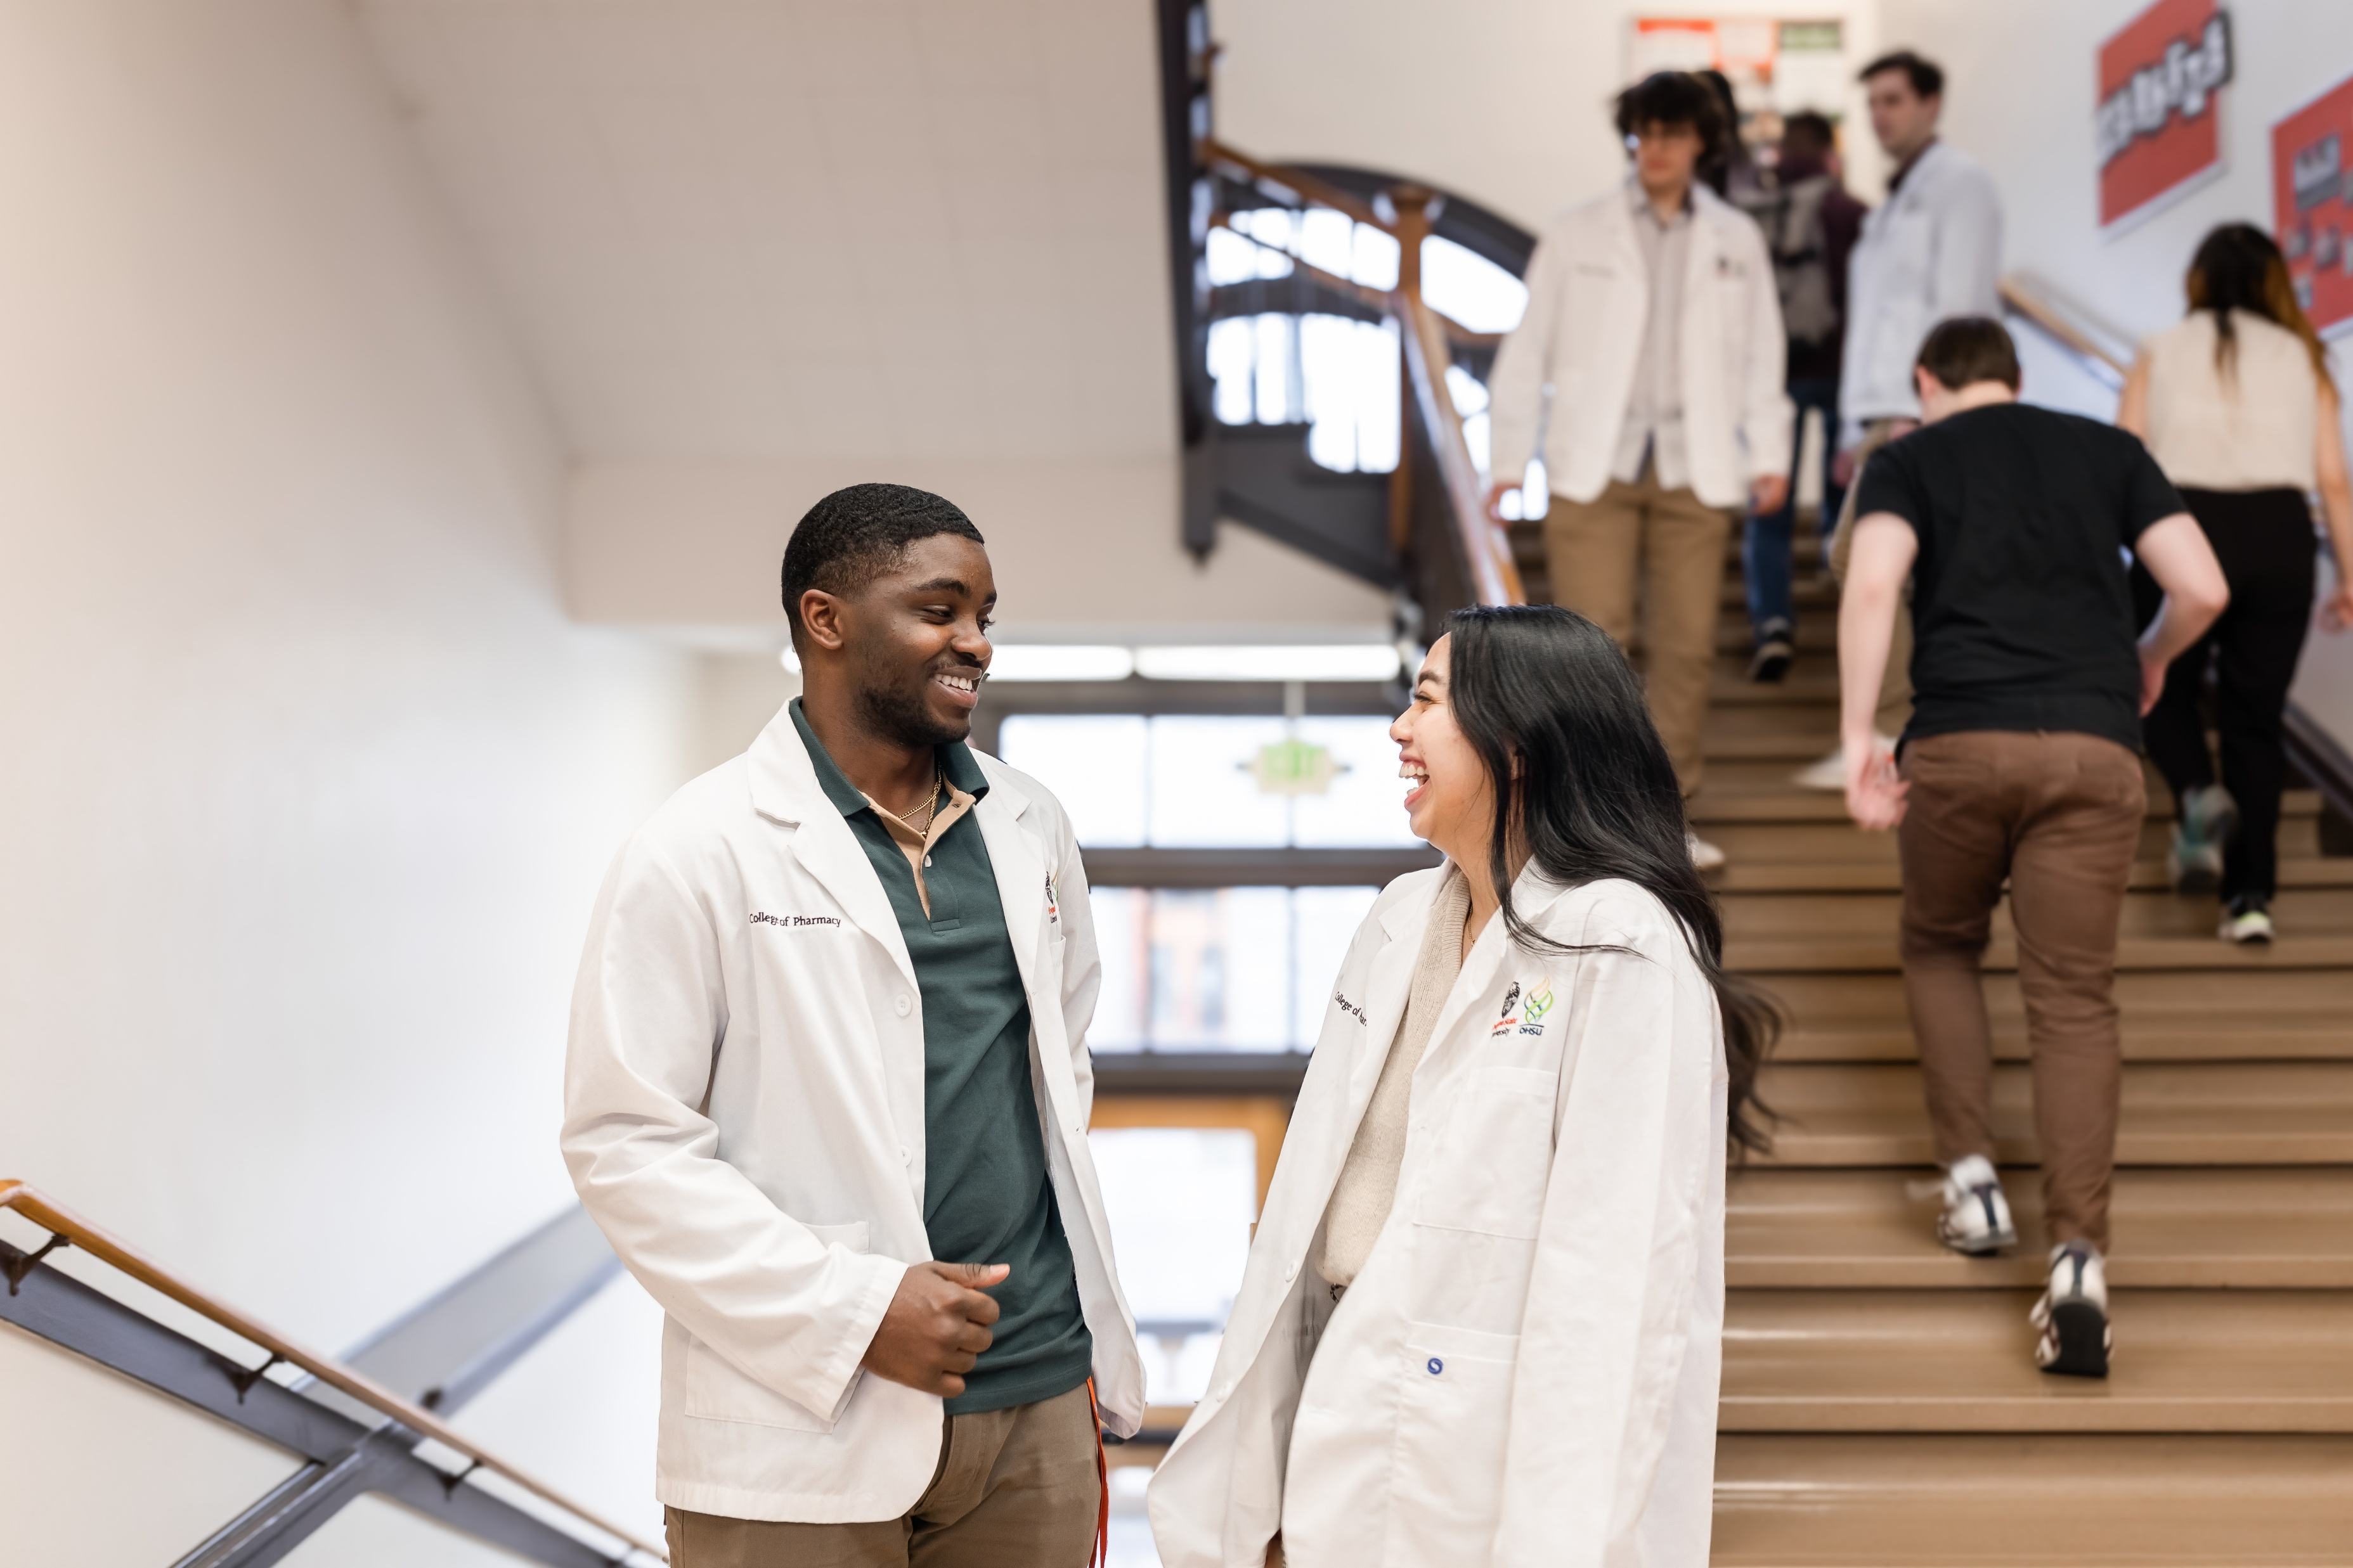
Other Pharmacy Careers
Pharmacy Technicians*
Pharmaceutical Scientists
Regulatory Specialists
And more!
Notes:
Pharmacy isn’t just about being a pharmacist! There are other important roles, such as:
Pharmacy Technicians: Assist pharmacists in preparing prescriptions. Did you know that over 50% of accepted applicants have prior paid pharmacy technician experience?
Pharmaceutical Scientists: Research and develop new medications.
Regulatory Specialists: Ensure medicines meet safety standards.
Which career interests you the most and why?" [Pause for responses]

Slide 11
How to become a Pharmacist
After high school:
Go to college
Go to pharmacy school
Complete licensure exam
Optional: Residency or Fellowship
Notes:
Finish High School – Focus on science and math because they help you understand how medicine works.
College Education: After high school, you’ll need to attend college for 2 – 4 years and study subjects like biology and chemistry prepare for pharmacy school.
Then go to pharmacy school:
Typically, pharmacy schools require a minimum of two years of college study followed by four years of pharmacy school.
Some schools offer accelerated programs, allowing you to complete pharmacy school in three years instead of four.
A few schools have “0-6” programs, where students start pharmacy school right after high school.
Hands-On Training – During pharmacy school, you’ll work in real pharmacies to practice helping people and using medicine safely.
Pass a Big Test – After school, you must pass the North American Pharmacist Licensure Examination (NAPLEX) to officially become a pharmacist.
Start Your Career or Keep Learning – Once you pass the test, you can:
Start Working as a pharmacist in a hospital, clinic, or store.
Do a Residency (1–2 years) to get extra training in areas like hospitals or cancer treatment.
Do a Fellowship (1–2 years) if you want to do research or help develop new medicines.
It takes about 8–10 years after high school, but pharmacists play a huge role in keeping people healthy!
Key Skills: Pharmacists need to be detail-oriented, good communicators, and problem-solvers.
What skills do you have now that would help you succeed as a pharmacist?" [Pause for responses]

Slide 12
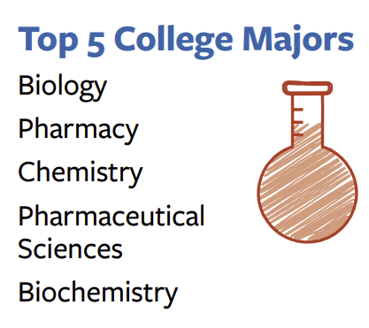
Pharmacy Admission Fast Facts
Source: PharmCAS “Building the Future of Pharmacy” Infographic

Slide 13
What Can You Do Now?
Right now, you should:
Talk to a pharmacist
Learn about medicines
Build a strong foundation in science and math
Visit pharmacyforme.org for more info!
Notes:
What Can You Do Now?
Talk to a Pharmacist: The next time you visit a pharmacy, ask the pharmacist about their job. They can share valuable insights about what it’s like to work in pharmacy.
Learn About Medicines: Pay attention to over-the-counter medications at home and read their labels to understand their uses and precautions.
Strong Science & Math Skills: Take classes in biology, chemistry, and math to build a solid foundation.

Slide 14
Pharmacy Trivia
Let’s test your pharmacy knowledge!

Slide 15
Pharmacy Trivia
How many prescription drugs are approved for use in the US?
A) Over 10,000
B) Over 15,000
C) Over 20,000
D) 1,000,000
Notes:
Prescription drugs are medicines that a doctor or healthcare professional must approve for a patient to use. They are stronger than over-the-counter medicines and need a special note, called a prescription, to be picked up at the pharmacy. These medicines help treat illnesses, manage conditions, and keep people healthy, but they must be used exactly as directed.
Answer: C) Over 23,000 medications are approved in the US
Over 50 new drugs enter the market each year.
Can you name a prescription medication you have seen a commercial for recently?

Slide 16
Pharmacy Trivia
How many Over-the-Counter medications are there in the Us?
A) Over 100,000
B) Over 300,000
C) Over 500,000
D) 1,000,000
Notes:
Over-the-counter (OTC) medicines are drugs you can buy without a prescription. They help treat common health problems like headaches, colds, allergies, and minor cuts. Even though they are easy to get, it's important to use them correctly by following the directions on the label and asking a parent or pharmacist if you're unsure.
Answer: B) Over 300,000 OTC meds
800 different active ingredients
80 different categories
Can you name any over-the-counter medicines?

Slide 17
Pharmacy Trivia
What popular drink was invented by a pharmacist?
A) Coca-Cola
B) Dr. Pepper
C) Pepsi
D) Ginger ale
Notes:
Answer They are all correct!!
Coca-Cola was invented by a pharmacist named John Stith Pemberton in 1886! He originally created it as a medicine, but it became a popular soft drink instead.
Dr. Pepper was invented in 1885. Texas pharmacist Charles Alderton formulated the drink made with 23 secret flavors.
Pepsi Cola was invented in 1893. North Carolina pharmacist Caleb Bradham served a mix of sugar, water, caramel, lemon oil, kola nuts, nutmeg, and other additives to create this beverage.
Canada Dry Ginger Ale was invented in 1907. Canadian pharmacist John McLaughlin developed the commercial version of Canada Dry Ginger Ale, which was first formulated in Ireland.
Many other pharmacists have also invented important medicines and products we use every day!

Slide 18
Pharmacy Trivia
How much does the most expensive drug cost in 2024?
A) $40
B) $400
C) $4000
D) $4,000,000
Notes:
Answer D): $4,000,000
The most expensive medicine in the world is called Lenmeldy, and it costs $4.25 million! It is a special gene therapy made to help children with a rare and serious disease called metachromatic leukodystrophy (MLD). This disease happens because of a change in a gene that causes harmful fats to build up in the body.

Slide 19
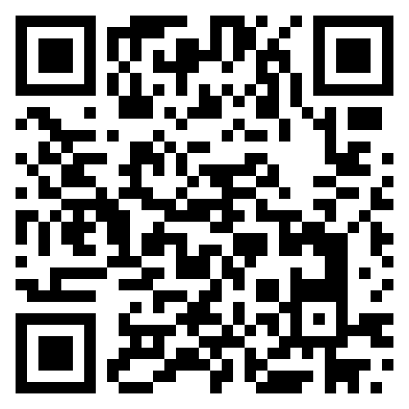
Take the Pharmacy Career Quiz
pharmacyforme.org/pharmacy-career-quiz
Notes:
If time allows, have attendees take the pharmacy career quiz and allow them to share their results.

Slide 20
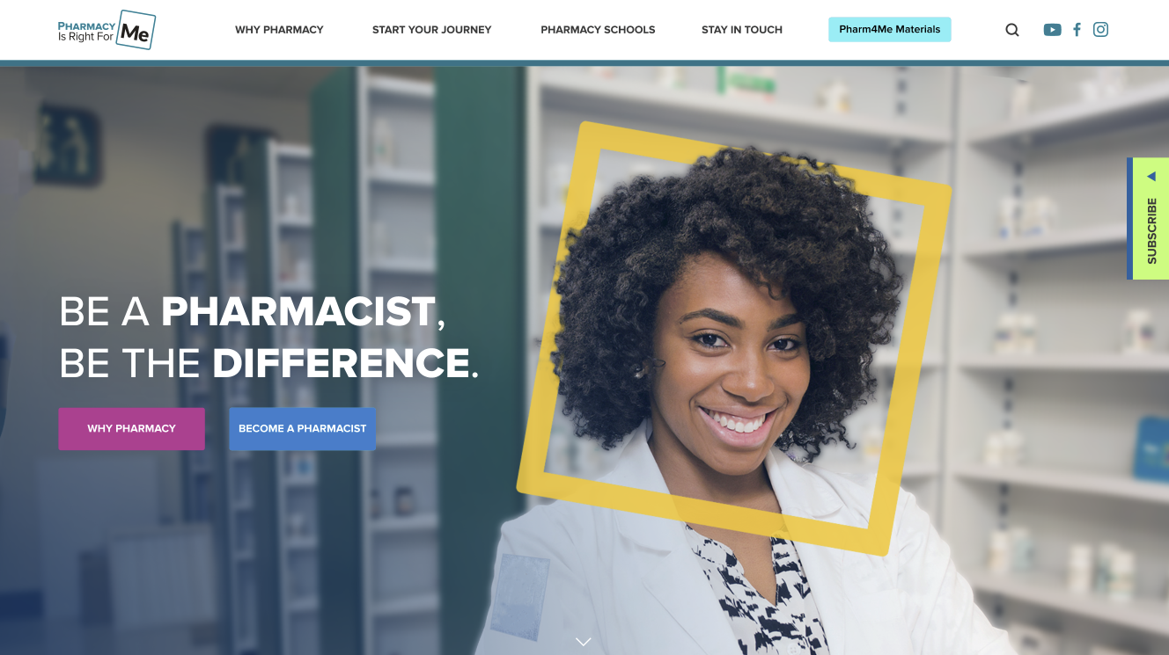
Check out these great resources!
Visit pharmacyforme.org
Follow @pharm4me
Subscribe to monthly newsletter

Slide 21
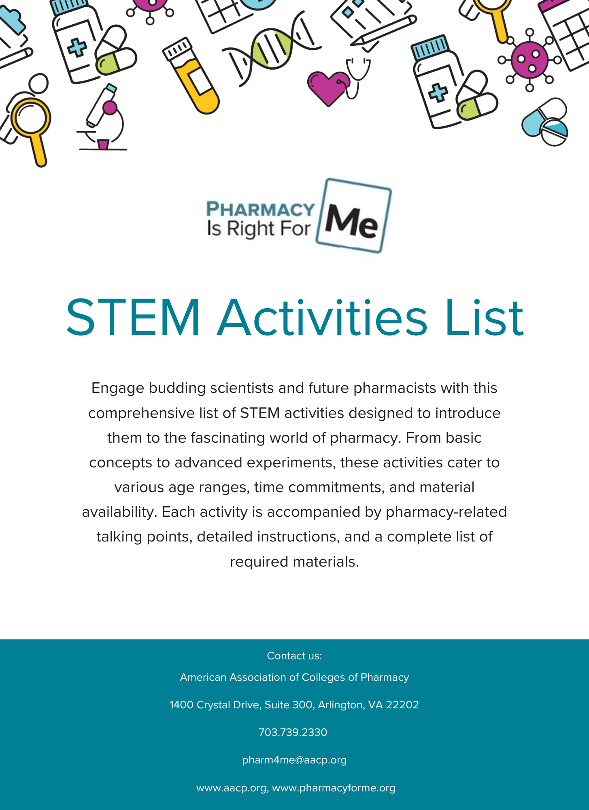
Looking for hands-on activities to add to this presentation?
Check out our STEM Activities List for engaging, hands-on activities and pharmacy-related talking points.

