Slide 1
How to Use This Pharm4Me Presentation
Welcome!
This pre-made pharmacy presentation is designed to introduce high school students to the world of pharmacy. It covers key topics like what pharmacists do, where they work, and the steps to becoming a pharmacist.
Feel free to customize the slides however you’d like! You can add personal stories, adjust the language to fit your students' level, or include interactive activities to make the lesson more engaging. This presentation is just a starting point—make it your own to best fit your teaching style and audience!
Enjoy sharing the exciting world of pharmacy with your students!
Sincerely,
AACP Staff
American Association of Colleges of Pharmacy
1400 Crystal Drive, Suite 300 ▪ Arlington, VA 22202
703.739.2330 (main)
pharm4me@aacp.org
www.aacp.org, www.pharmacyforme.org

Slide 2
Introduction to Pharmacy and Pharmacy Careers
For High School Students

Slide 3
Introduce yourself…
Notes:
Hey everyone! My name is [Your Name], and today we’re diving into the world of pharmacy.

Slide 4
What do pharmacists do?
Notes:
Ask audience: What do you think pharmacists do?
[Pause for answers]

Slide 5
What do pharmacists do?
Develop medication treatment plans in collaboration with other health care professionals
Identify and prevent harmful drug interactions
Use point-of-care tests to assess a patient’s health status (e.g., tests for flu, strep, COVID-19).
Administer immunizations for vaccine preventable conditions

Slide 6
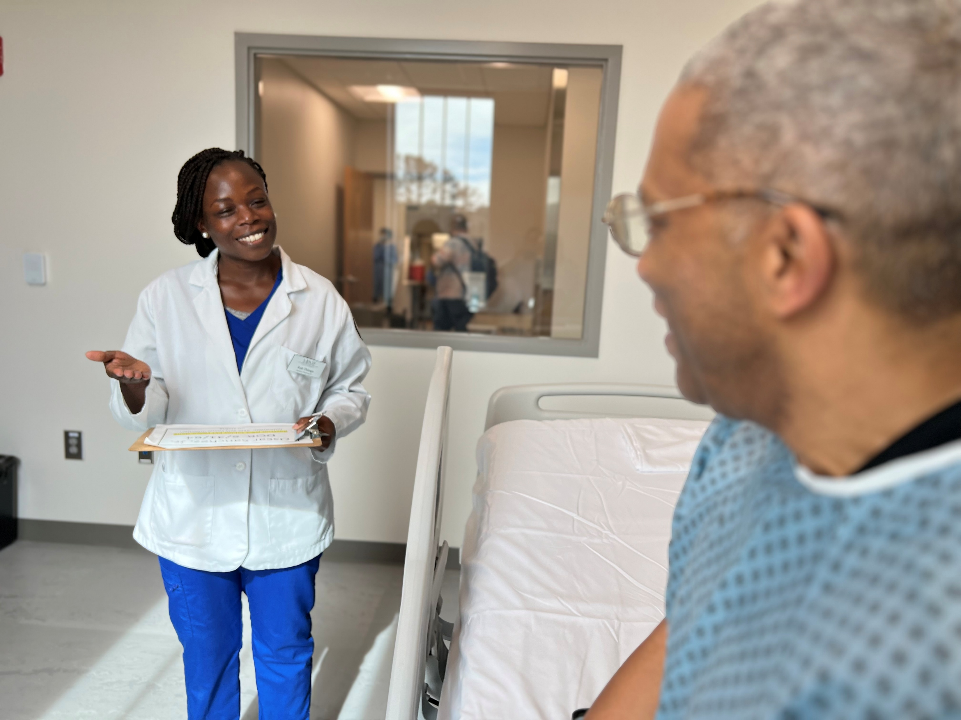
What do pharmacists do?
Help patients to safely reduce or eliminate acute short-term and long-term pain
Apply knowledge about how genes affect a person’s response to medications
Order, monitor, interpret, and verify lab and test results for various health conditions.

Slide 7
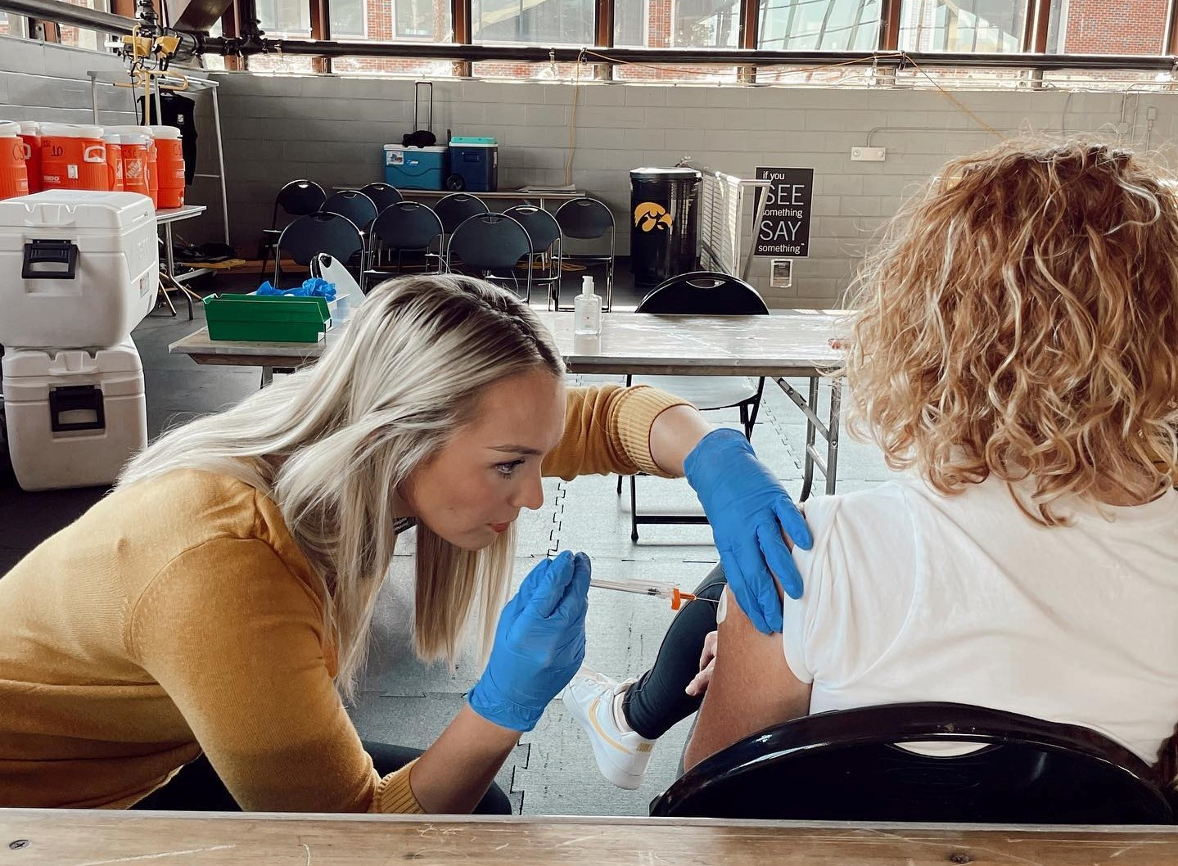
What do pharmacists do?
Research and develop new medicines
Create personalized medication plans
Promote public health (ex.: Stopping the spread of COVID-19)
Manage chronic diseases (ex.: diabetes, heart failure)
Notes:
Pharmacists play a crucial role in healthcare by:
Develop new medicines
Pharmacists might work on a research team or for a pharmaceutical company researching and developing new medicines.
Create personalized medications for patients
Some patients are taking many medications and pharmacists help make sure their patients are using medications correctly, at the correct amount, and make sure they don’t interact with other medications.
Promote public health
During the COVID-19 pandemic, pharmacists played a crucial role in keeping everyone safe by giving out vaccines, medications, and important health information. They helped patients’ symptoms get better, made sure medicine was available for everyone, and helped prevent the spread of the virus. Many pharmacies can test patients for illnesses like COVID or the Flu and prescribe medications for them to use.
Manage chronic diseases
Some pharmacists also specialize in treating diseases like diabetes, asthma, or heart disease. Often, these patients are taking many medications, and their pharmacist can help them to be on the most effective medication plan, reduce costs, and decrease side effects.

Slide 8
Pharmacists help people live better, healthier lives.
Video used with permission. American Society of Health-System Pharmacists. Your Pharmacist Video Campaign. 2025. Available at: https://www.yourpharmacist.org/

Slide 9
Where do Pharmacists work?
Community
Hospital or Clinics
Research Labs
Industry or Government
Telehealth
Notes:
Pharmacists work in many different places. They can be found in:
Community Pharmacies (like CVS, Walgreens, or local, independent pharmacies).
Hospitals, working alongside doctors and nurses.
Research Labs, developing new medicines.
Government Agencies, ensuring medication safety.
Telehealth, providing distance care.
Basically, anywhere there is a medication, there is a pharmacist!
Which of these settings do you think would be the most interesting to work in and why? [Pause for responses]

Slide 10
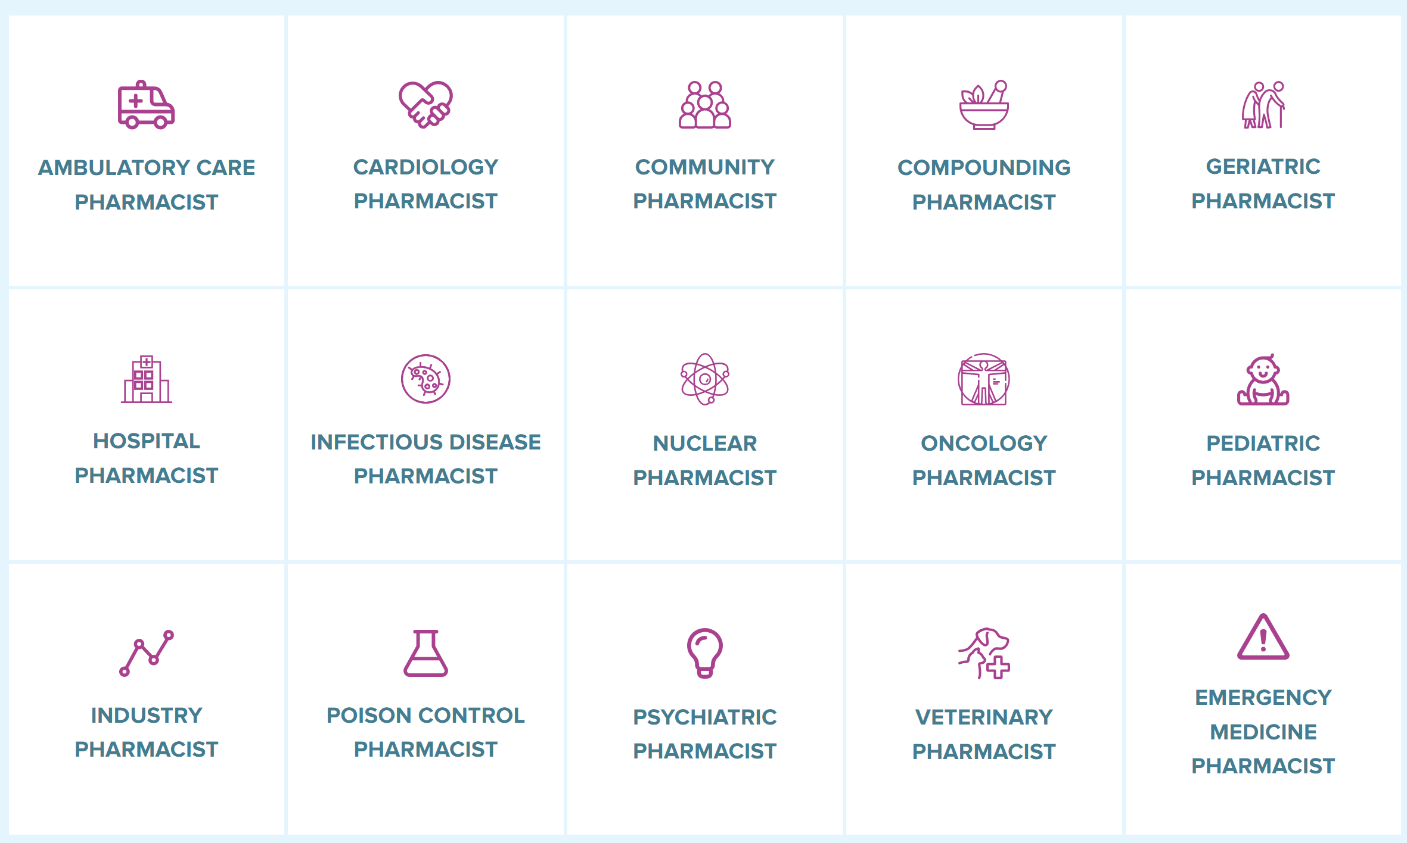
Specialty Areas
Notes:
A fact many don’t know is that as a pharmacist, you can specialize in a variety of areas and even earn additional board certifications through the Board of Pharmacy Specialties (BPS) in order to provide more advanced care.

Slide 11
Pharmaceutical Scientists
Notes:
Pharmacy isn’t just about being a pharmacist! There are other important roles, such as: Pharmaceutical Scientists: They help develop new medications, improve drug safety, and find better treatments for diseases. Some work in laboratories, testing how medicines work in the body. Others study data to make sure drugs are safe and effective for everyone.
If you like science, problem-solving, and making discoveries, a career in pharmacy research might be for you! You could work in universities, pharmaceutical companies, or even government agencies like the FDA.

Slide 12
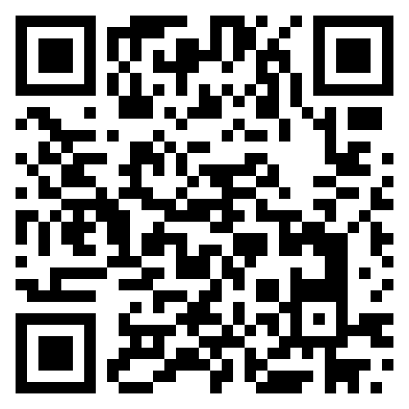
Take the Pharmacy Career Quiz
pharmacyforme.org/pharmacy-career-quiz
Notes:
Let’s see what career may be a good fit for you! Please note this is just a fun activity to help you explore unique pharmacy careers.

Slide 13
How to become a Pharmacist
After high school:
Go to college
Go to pharmacy school
Complete licensure exam
Optional: Residency or Fellowship
Notes:
Path to Becoming a Pharmacist
High School (Now!)
Focus on science (biology, chemistry) and math (algebra, statistics).
Take AP or dual-credit courses if available.
Gain experience through volunteering at hospitals or pharmacies.
Optional: become a pharmacy technician to get further experience in the field.
College (2-4 years)
Earn a Bachelor’s degree (and/or complete the required prerequisite courses). Many pharmacy schools do not require a bachelor’s degree but instead only 2 years worth of prerequisites.
Maintain good grades and get involved in healthcare-related activities, such as becoming a pharmacy tech.
Pharmacy School (3-4 years)
Complete a Doctor of Pharmacy (PharmD) degree from an accredited school.
Learn about medicines, patient care, and how to run a pharmacy.
Gain hands-on experience through internships and rotations.
Licensing & Exams
Pass the NAPLEX (North American Pharmacist Licensure Exam).
Pass a state-specific law exam (MPJE or equivalent).
5. Optional: RESIDENCY: 1–2 years of postgraduate training focused on certain patient populations or disease states in a clinical setting.
FELLOWSHIP: Individualized postgraduate training with a focus in academia, research, or industry.
CERTIFICATION: Licensed pharmacists may choose to become board certified as a way to demonstrate pharmacy expertise in a specialty area of practice: Ambulatory Care, Cardiology, Compounded Sterile Preparations, Critical Care, Emergency Medicine, Geriatric, Infectious Diseases, Nuclear, Nutrition Support Oncology, Pain Management, Pediatric, Pharmacotherapy, Psychiatric and Solid Organ Transplantation.
Start Your Career!
It takes about 8–10 years after high school, but pharmacists play a huge role in keeping people healthy!
Key Skills: Pharmacists need to be detail-oriented, good communicators, and problem-solvers.
What skills do you have now that would help you succeed as a pharmacist?" [Pause for responses]

Slide 14
Common Prerequisites
General Chemistry General Biology
Physics
Organic Chemistry
Human Anatomy Physiology
Biochemistry
Microbiology
Calculus
Statistics
English Composition
Public Speaking
Ethics or Philosophy
Humanities
Behavioral & Social Science
Economics
Notes:
Prerequisites for admission vary by school. Specific college requirements can be found in the PharmCAS Compare Pharm.D. Programs feature but typical prerequisite courses may include:

Slide 15
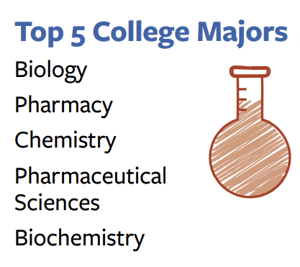
Pharmacy Admission Fast Facts
Source: PharmCAS “Building the Future of Pharmacy” Infographic

Slide 16
What Can You Do Now?
Right now, you should:
Talk to a pharmacist
Learn about medicines
Build a strong foundation in science and math
Look into becoming a pharmacy technician
Visit pharmacyforme.org for more info!
Notes:
What Can You Do Now?
Talk to a Pharmacist: The next time you visit a pharmacy, ask the pharmacist about their job. They can share valuable insights about what it’s like to work in pharmacy.
Learn About Medicines: Pay attention to over-the-counter medications at home and read their labels to understand their uses and precautions.
Strong Science & Math Skills: Take classes in biology, chemistry, and math to build a solid foundation.
Look into becoming a pharmacy technician (more info on next slide)

Slide 17
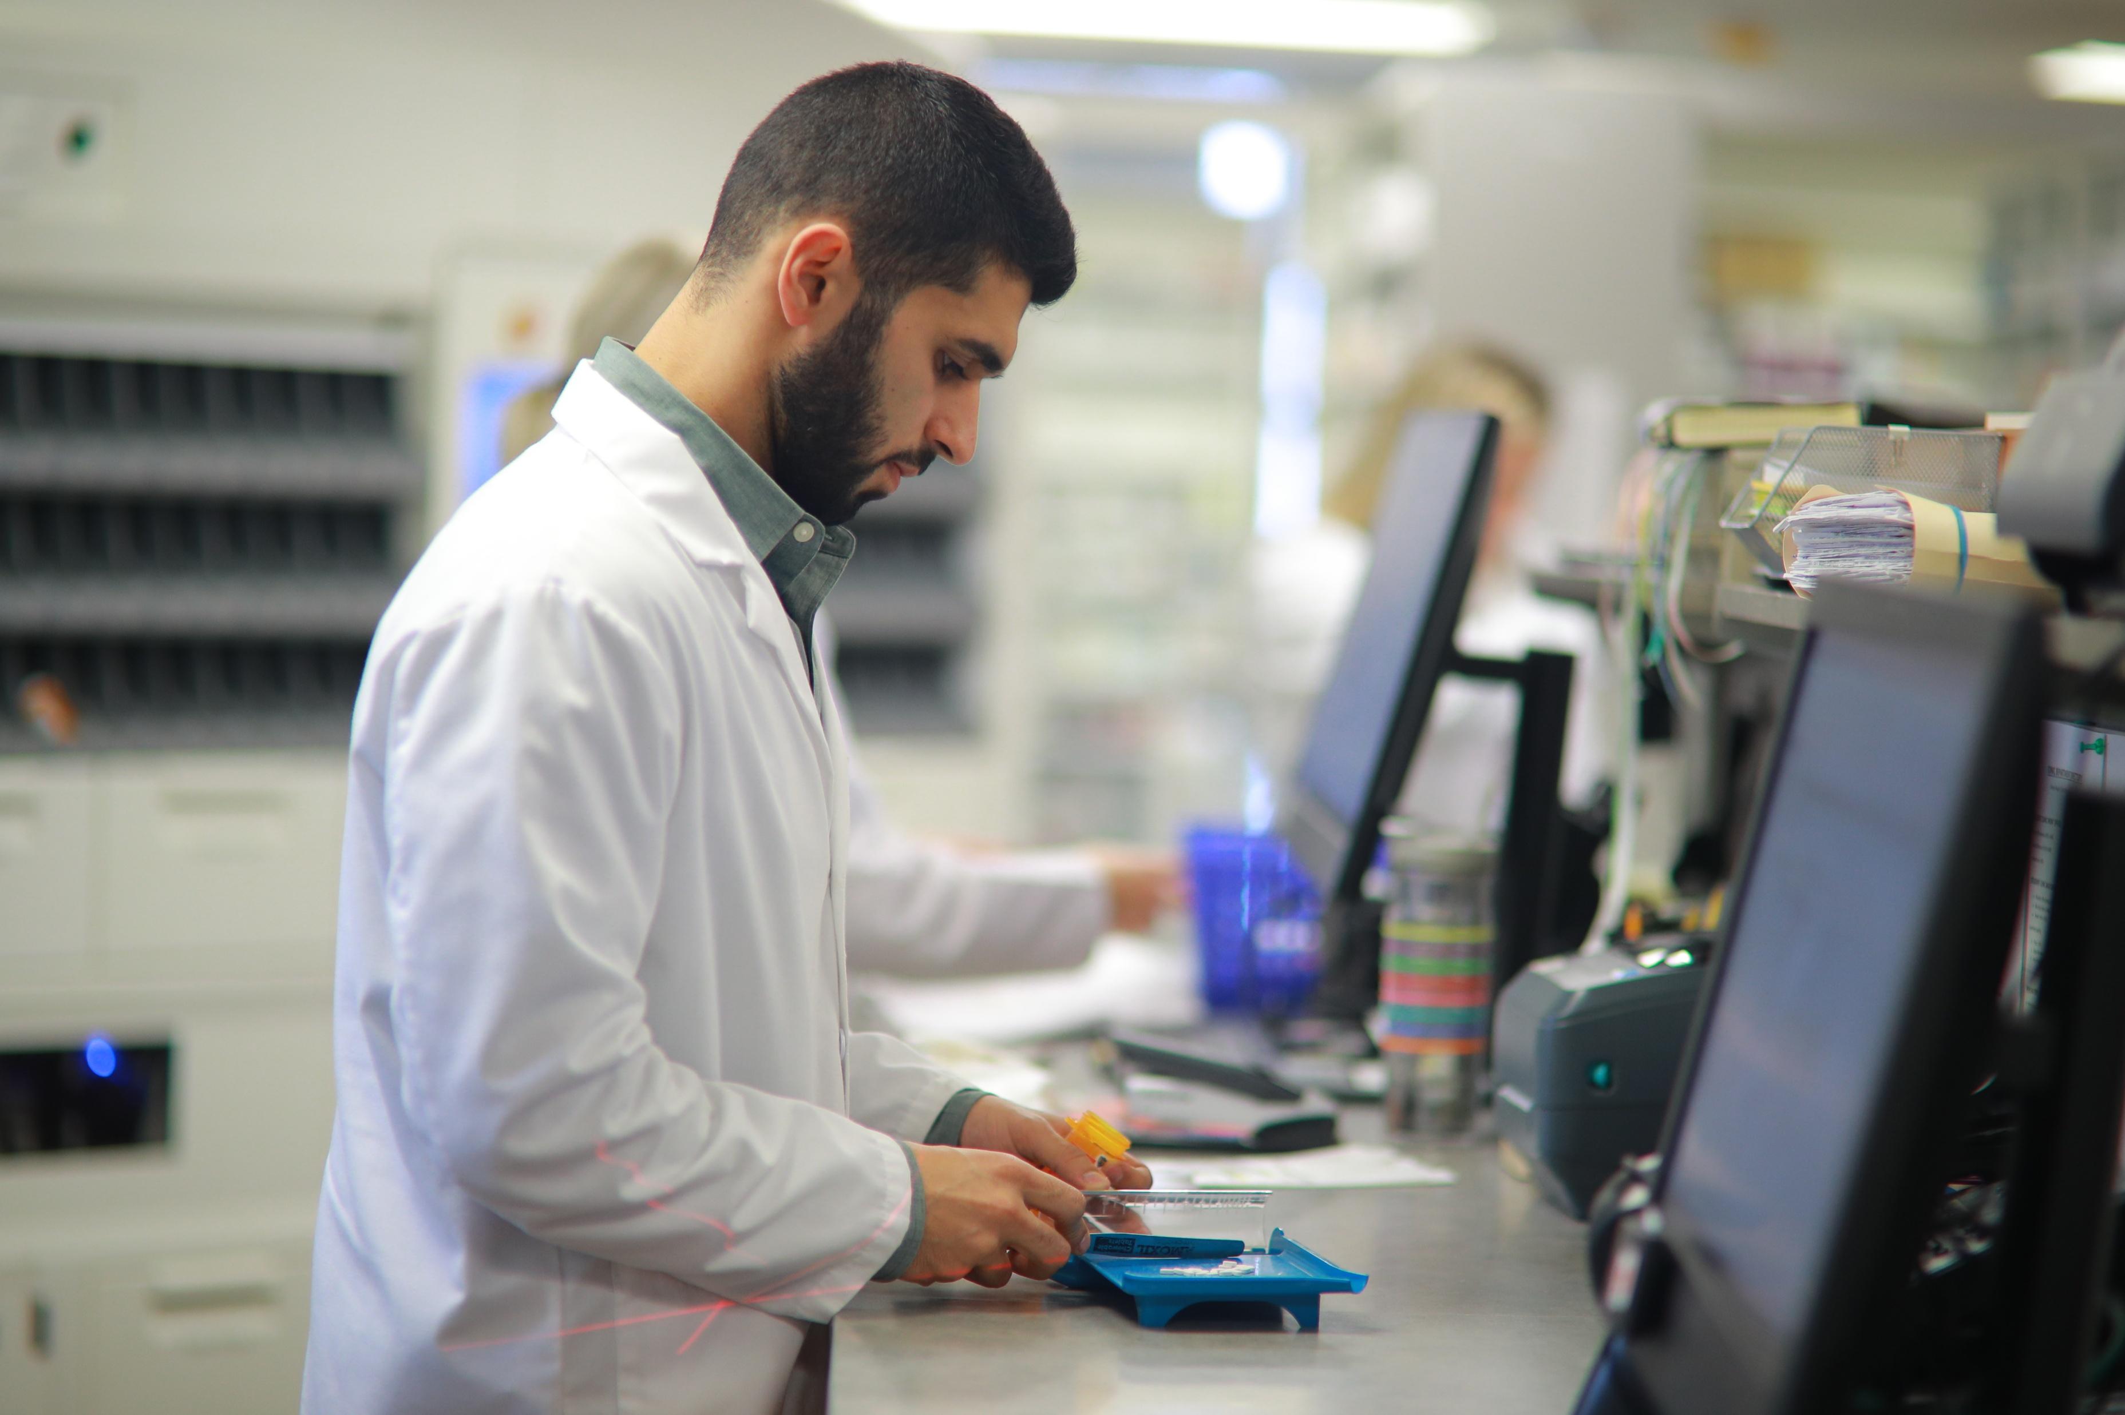
Pharmacy Technicians
After high school, complete a Pharmacy Technician Training Program
Some tasks include:
Enter prescription orders
Package prescriptions
Manage medication therapy
Assist with immunizations
And more!
Learn more at ptcb.org
Notes:
Pharmacy technician experience isn’t required for pharmacy school, but it can be valuable on the path to becoming a pharmacist. In fact, over half of accepted students have paid pharmacy technician experience prior to enrolling in a Pharm.D. program. Furthermore, according to the Pharmacy Technician Certification Board (PTCB), “Pharmacy technicians are in high demand all across the country with positions available in all types of practice settings. While specific responsibilities will vary, a technician may:
Enter prescription orders
Package prescriptions
Operate automated dispensing systems
Maintain inventories
Process insurance claims
Check/verify other technicians’ work
Compound sterile preparations
Manage medication therapy
Assist with immunizations
Finish High School or Get a GED
Focus on math, biology, and chemistry to build a strong foundation.
Some high schools offer pharmacy tech programs—check if yours does!
Complete a Pharmacy Technician Training Program (Optional but Recommended)
Many community colleges, vocational schools, and online programs offer training.
Programs take a few months to a year and cover pharmacy law, drug names, and calculations.
Gain Hands-on Experience
Some states allow on-the-job training, where you learn while working at a pharmacy.
Internships or apprenticeships can help you get hired faster.
Get Certified (Often Required)
Take the Pharmacy Technician Certification Exam (PTCE) or ExCPT to become certified.
Certification helps with job opportunities and higher pay.
Apply for State Licensure (If Required)
Some states require registration or licensing before you can work.
Check your state’s requirements to stay compliant.

Slide 18
Future Prospects in Pharmacy
Projected 5% growth between 2023 - 2033
Median Annual Salary in 2023
Growing Field
$136,030
2023 US Bureau of Labor Statistics
2023 US Bureau of Labor Statistics
More focus on
Patient Care
Technology
Notes:
Job prospects in pharmacy are promising, driven by an aging population, increasing prevalence of chronic diseases, and the expanding role of pharmacists in patient care. Demand for pharmacists remains strong in community and hospital settings, where they play a critical role in medication management and patient counseling. Additionally, opportunities are growing in specialized fields like oncology, geriatrics, and infectious disease. Emerging areas such as pharmacogenomics and personalized medicine also offer new career paths. Technological advancements and the integration of pharmacists into broader healthcare teams further enhance job prospects, making pharmacy a dynamic and evolving field with a wide range of employment opportunities.

Slide 19
Pharmacy Trivia
Let’s test your pharmacy knowledge!

Slide 20
Pharmacy Trivia
How many prescription drugs are approved for use in the US?
A) Over 10,000
B) Over 15,000
C) Over 20,000
D) 1,000,000
Notes:
Prescription drugs are medicines that a doctor or healthcare professional must approve for a patient to use. They are stronger than over-the-counter medicines and need a special note, called a prescription, to be picked up at the pharmacy. These medicines help treat illnesses, manage conditions, and keep people healthy, but they must be used exactly as directed.
Answer: C) Over 23,000 medications are approved in the US
Over 50 new drugs enter the market each year.

Slide 21
Pharmacy Trivia
How many Over-the-Counter medications are there in the Us?
A) Over 100,000
B) Over 300,000
C) Over 500,000
D) 1,000,000
Notes:
Over-the-counter (OTC) medicines are drugs you can buy without a prescription. They help treat common health problems like headaches, colds, allergies, and minor cuts. Even though they are easy to get, it's important to use them correctly by following the directions on the label and asking a parent or pharmacist if you're unsure.
Answer: B) Over 300,000 OTC meds
800 different active ingredients
80 different categories
Can you name any over-the-counter medicines?

Slide 22
Pharmacy Trivia
What popular drink was invented by a pharmacist?
A) Coca-Cola
B) Dr. Pepper
C) Pepsi
D) Ginger ale
Notes:
Answer They are all correct!!
Coca-Cola was invented by a pharmacist named John Stith Pemberton in 1886! He originally created it as a medicine, but it became a popular soft drink instead.
Dr. Pepper was invented in 1885. Texas pharmacist Charles Alderton formulated the drink made with 23 secret flavors.
Pepsi Cola was invented in 1893. North Carolina pharmacist Caleb Bradham served a mix of sugar, water, caramel, lemon oil, kola nuts, nutmeg, and other additives to create this beverage.
Canada Dry Ginger Ale was invented in 1907. Canadian pharmacist John McLaughlin developed the commercial version of Canada Dry Ginger Ale, which was first formulated in Ireland.
Many other pharmacists have also invented important medicines and products we use every day!

Slide 23
Pharmacy Trivia
How much does the most expensive drug cost in 2024?
A) $40
B) $400
C) $4000
D) $4,000,000
Notes:
Answer D): $4,000,000
The most expensive medicine in the world is called Lenmeldy, and it costs $4.25 million! It is a special gene therapy made to help children with a rare and serious disease called metachromatic leukodystrophy (MLD). This disease happens because of a change in a gene that causes harmful fats to build up in the body.

Slide 24
Pharmacy Trivia
What percentage of Americans live within 5 miles of a pharmacy?
A) 30%
B) 50%
C) 90%
D) 100%
Notes:
C is correct! 90% of Americans live within 5 miles of a pharmacy—this is why pharmacists are one of the most accessible health care providers.
Anyone can walk into a pharmacy without an appointment and speak to a clinically-trained health care provider.
And, patients visit their pharmacist more than 2 times as often as they visit their physician. (J Manag Care Spec Pharm. 2022 Jan;28(1):10.18553/jmcp.2022.28.1.85. doi: 10.18553/jmcp.2022.28.1.85)
Can you name any over-the-counter medicines?

Slide 25
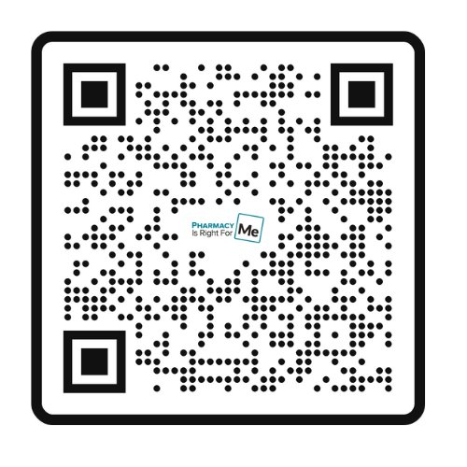
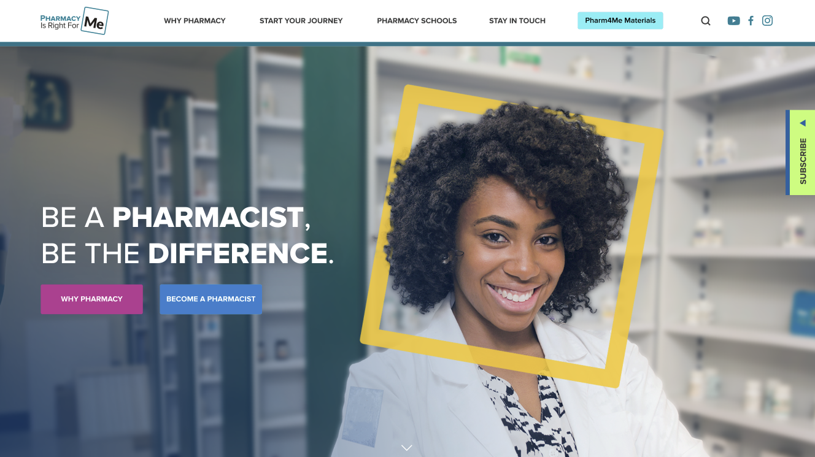
Check out these great resources!
Visit pharmacyforme.org
Follow @pharm4me
Subscribe to monthly newsletter

Slide 26
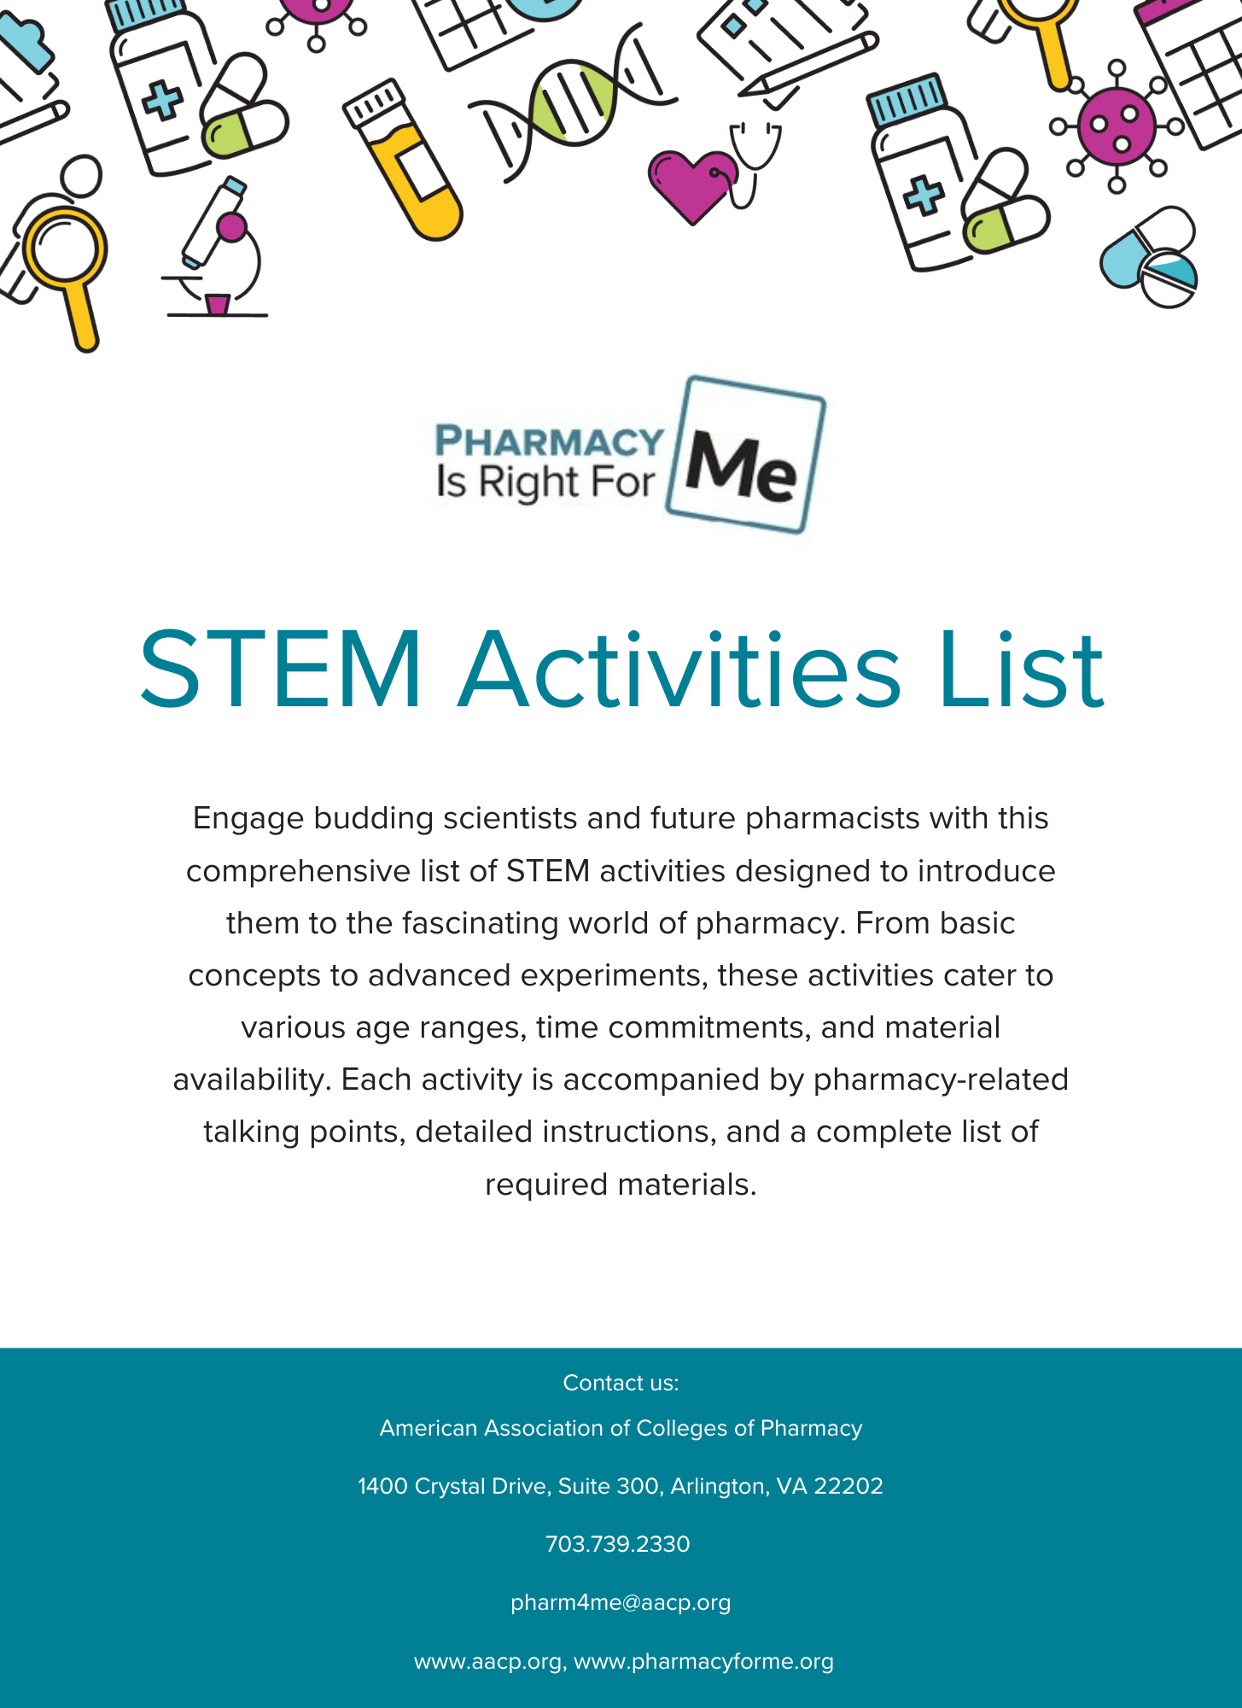
Looking for hands-on activities to add to this presentation?
Check out our STEM Activities List for engaging, hands-on activities and pharmacy-related talking points.

