Slide 1
How to Use This Pharm4Me Presentation
Welcome!
This pre-made pharmacy presentation is designed to introduce elementary school students to the world of pharmacy in a fun and simple way. It covers key topics like what pharmacists do, where they work, and how they help people stay healthy.
Feel free to customize the slides however you’d like! You can add personal stories, adjust the language to fit your students' level, or include interactive activities to make the lesson more engaging. This presentation is just a starting point—make it your own to best fit your teaching style and audience!
Enjoy sharing the exciting world of pharmacy with your students!
Sincerely,
AACP Staff
American Association of Colleges of Pharmacy
1400 Crystal Drive, Suite 300 ▪ Arlington, VA 22202
703.739.2330 (main)
pharm4me@aacp.org
www.aacp.org, www.pharmacyforme.org

Slide 2
Introduction to Pharmacy and Pharmacy Careers
For Elementary School Kids

Slide 3
Introduce yourself…

Slide 4
How does medicine know where to go?
Notes:
When you take a pill, for example, the medicine first enters your stomach before going into your bloodstream. Your blood carries it all around your body until it reaches the right spot, like a headache, a sore throat, or an infection. Some medicines work quickly, while others take time to build up in your system. That’s why it’s important to take medicine exactly as instructed by a doctor or pharmacist!
Why do you think it’s important to take medicine the right way? [Pause for responses]

Slide 5
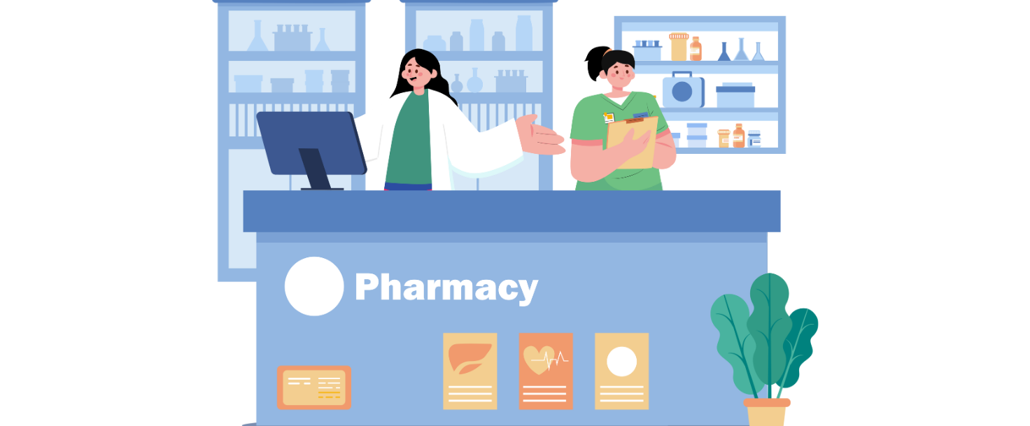
Where do we get medicine?
Notes:
Has anyone ever been to a pharmacy before? What do you think a pharmacy is?
[pause for responses]
A pharmacy is a place where people get medicine when they are sick or need to feel better. Pharmacists work there to make sure everyone gets the right medicine and knows how to use it safely.

Slide 6
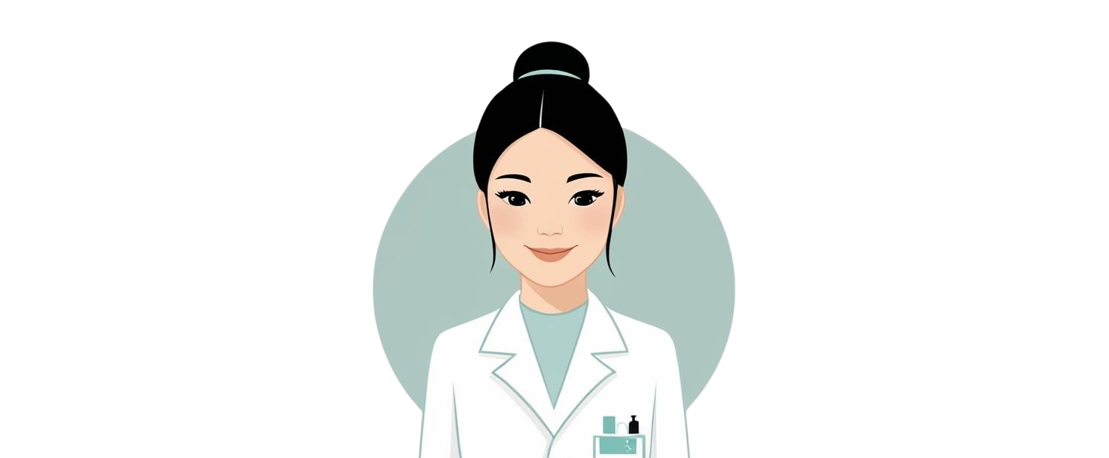
What is a Pharmacist?
Notes:
A pharmacist is a person who helps people get the right medicine. They make sure medicine is safe and that people know how to use it. They are like ‘medicine helpers’!
Can anyone guess what kind of medicines a pharmacist might give to people?
[pause for responses]

Slide 7
Game Time
Give the medicine to the right patient!
Notes:
You are now a pharmacist. I will show you a picture of a remedy, and you have to give it to the right person!
Really quick, pop quiz: Should we take medicine by ourselves? No! We should only take medicine from a doctor, parent, or pharmacist.

Slide 8
Which patient needs cough syrup?

Slide 9
Which patient needs antibiotics?

Slide 10
Which patient needs pain medication?

Slide 11
Which patient needs an inhaler?

Slide 12
Where do pharmacists work?
Notes:
Pharmacists can work in many different places! Some work in community pharmacies such as CVS, Walgreens or local pharmacies, some work in hospitals or clinics helping doctors, and some work in labs creating new medicine.
Basically, anywhere there are medications, there is a place for a pharmacist.
Did you know that your pets have their own pharmacist too? That’s right! You can become a veterinary pharmacist and work with animals such as cats and dogs.
Who here has a pet? Has your pet ever needed medicine?
[pause for responses]

Slide 13
Who else works in pharmacy?
Notes:
There are other important jobs in a pharmacy too! A pharmacy technician helps the pharmacist prepare medicine. A scientist makes new medicines in a lab. A teacher teaches new pharmacists!
Lead the following activity:
Role Rotation
Set up different "career stations" around the room with simple tasks representing different pharmacy jobs (e.g., counting "pills" with beads for a Pharmacy Tech, reading a prescription for a Pharmacist, mixing colored water for a Scientist, etc).
Students rotate through stations, completing a short task and learning about each career.

Slide 14
How can YOU become a pharmacist?
4. Take a big test
3. Go to pharmacy school
2. Go to college
Finish School
Notes:
Becoming a pharmacist takes an exciting journey to become a medicine expert! Here’s how it works:
1. Finish School – First, you go to school just like now, learning math, science, and reading.
2. Go to College – After high school, you go to college for about 2 to 4 years to learn more about science and medicine.
3. Pharmacy School – Next, you go to a special school called pharmacy school for another 3 to 4 years. Here, you learn all about how medicine works and how to help people feel better. You also work with other pharmacists and doctors, nurses, etc. in hospitals or pharmacies to practice and learn. Did you know there are over 140 pharmacy schools in the US.
5. Big Test - After all that learning, you take a big test. When you pass, you become a licensed pharmacist!

Slide 15
Let's test what you learned!
Who gives people medicine?
Doctor / Pharmacist / Teacher
Where do pharmacists work?
Hospital / Veterinarian Office / Pharmacy
Should you take medicine by yourself?
Yes / No

Slide 16
Thank you!
Notes:
[Give out stickers or certificates]
Great job today! Who thinks they might want to be a pharmacist when they grow up? Thank you for learning with me today!

Slide 17
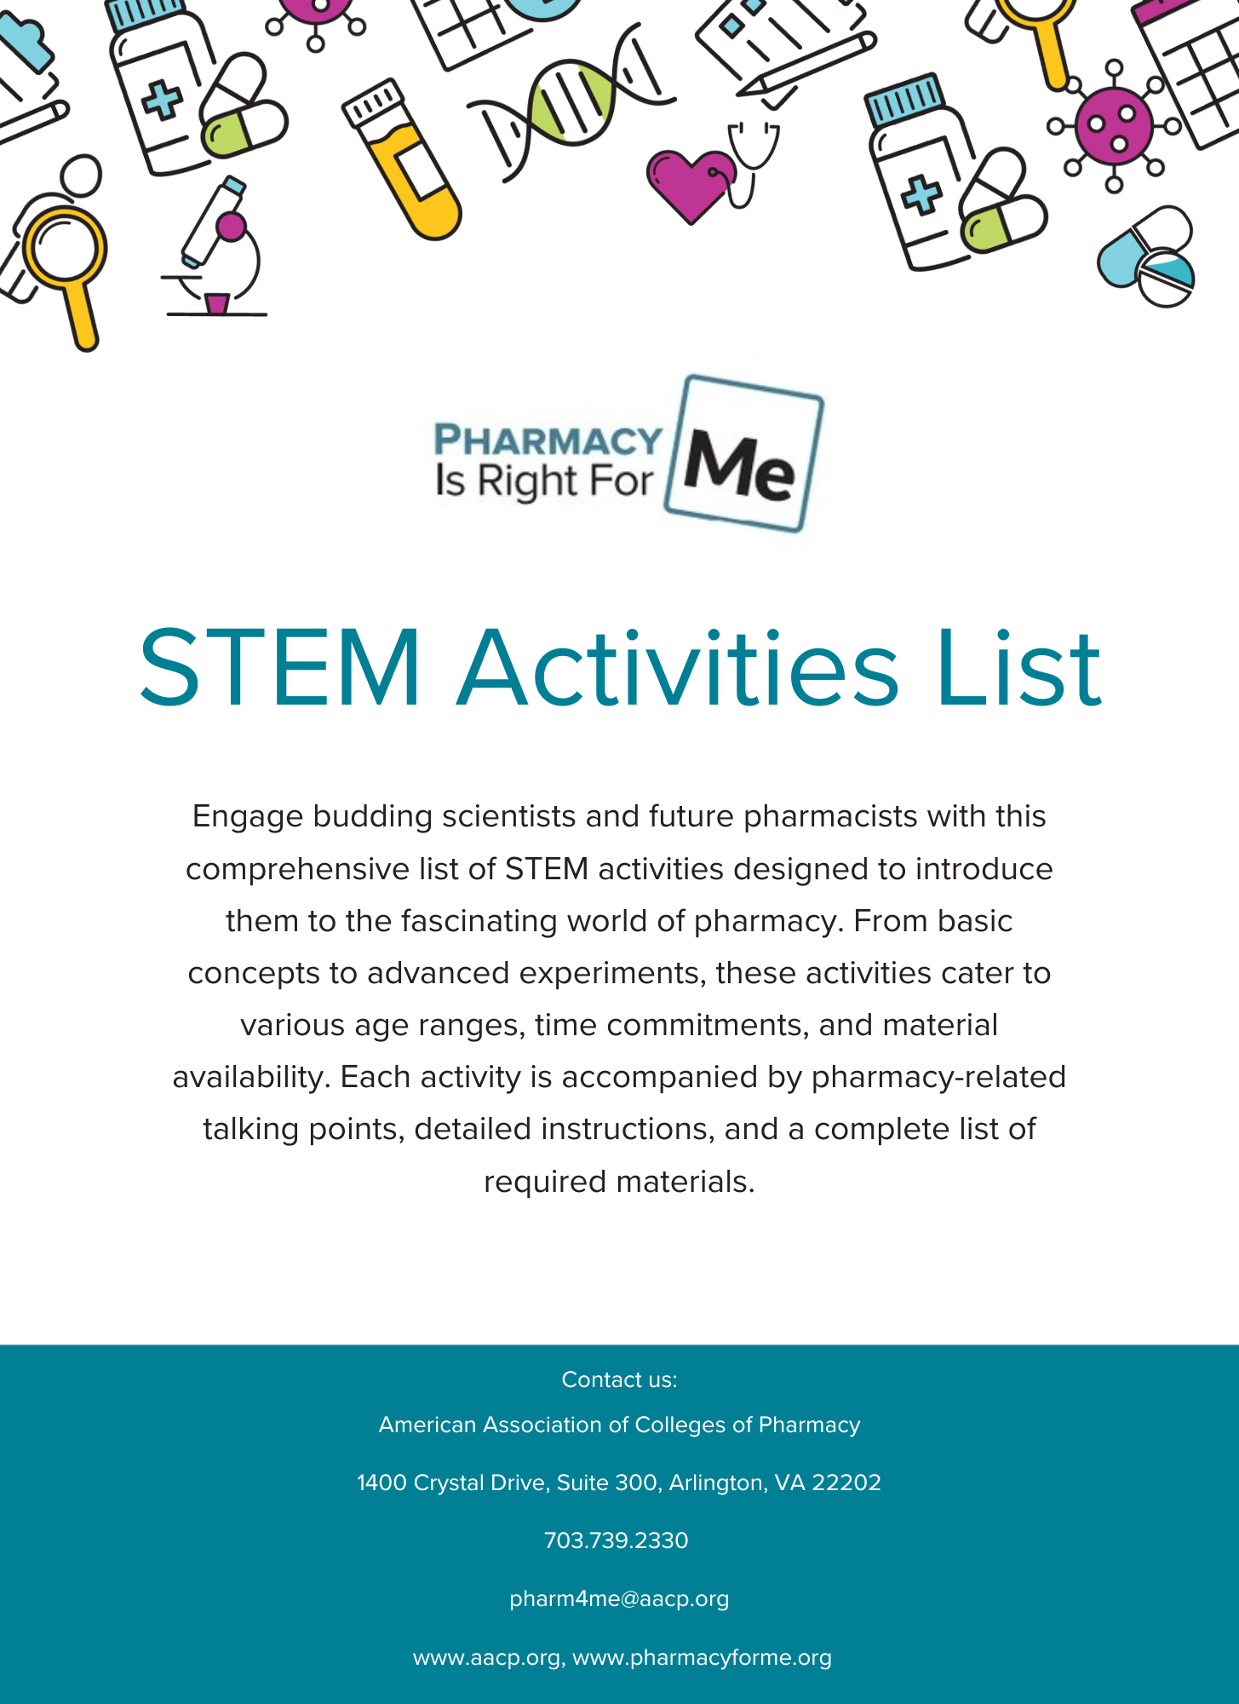
Looking for more activities to add to this presentation?
Check out our STEM Activities List for engaging, hands-on activities and pharmacy-related talking points and our Kids’ Corner for fun, interactive worksheets.

