Slide 1




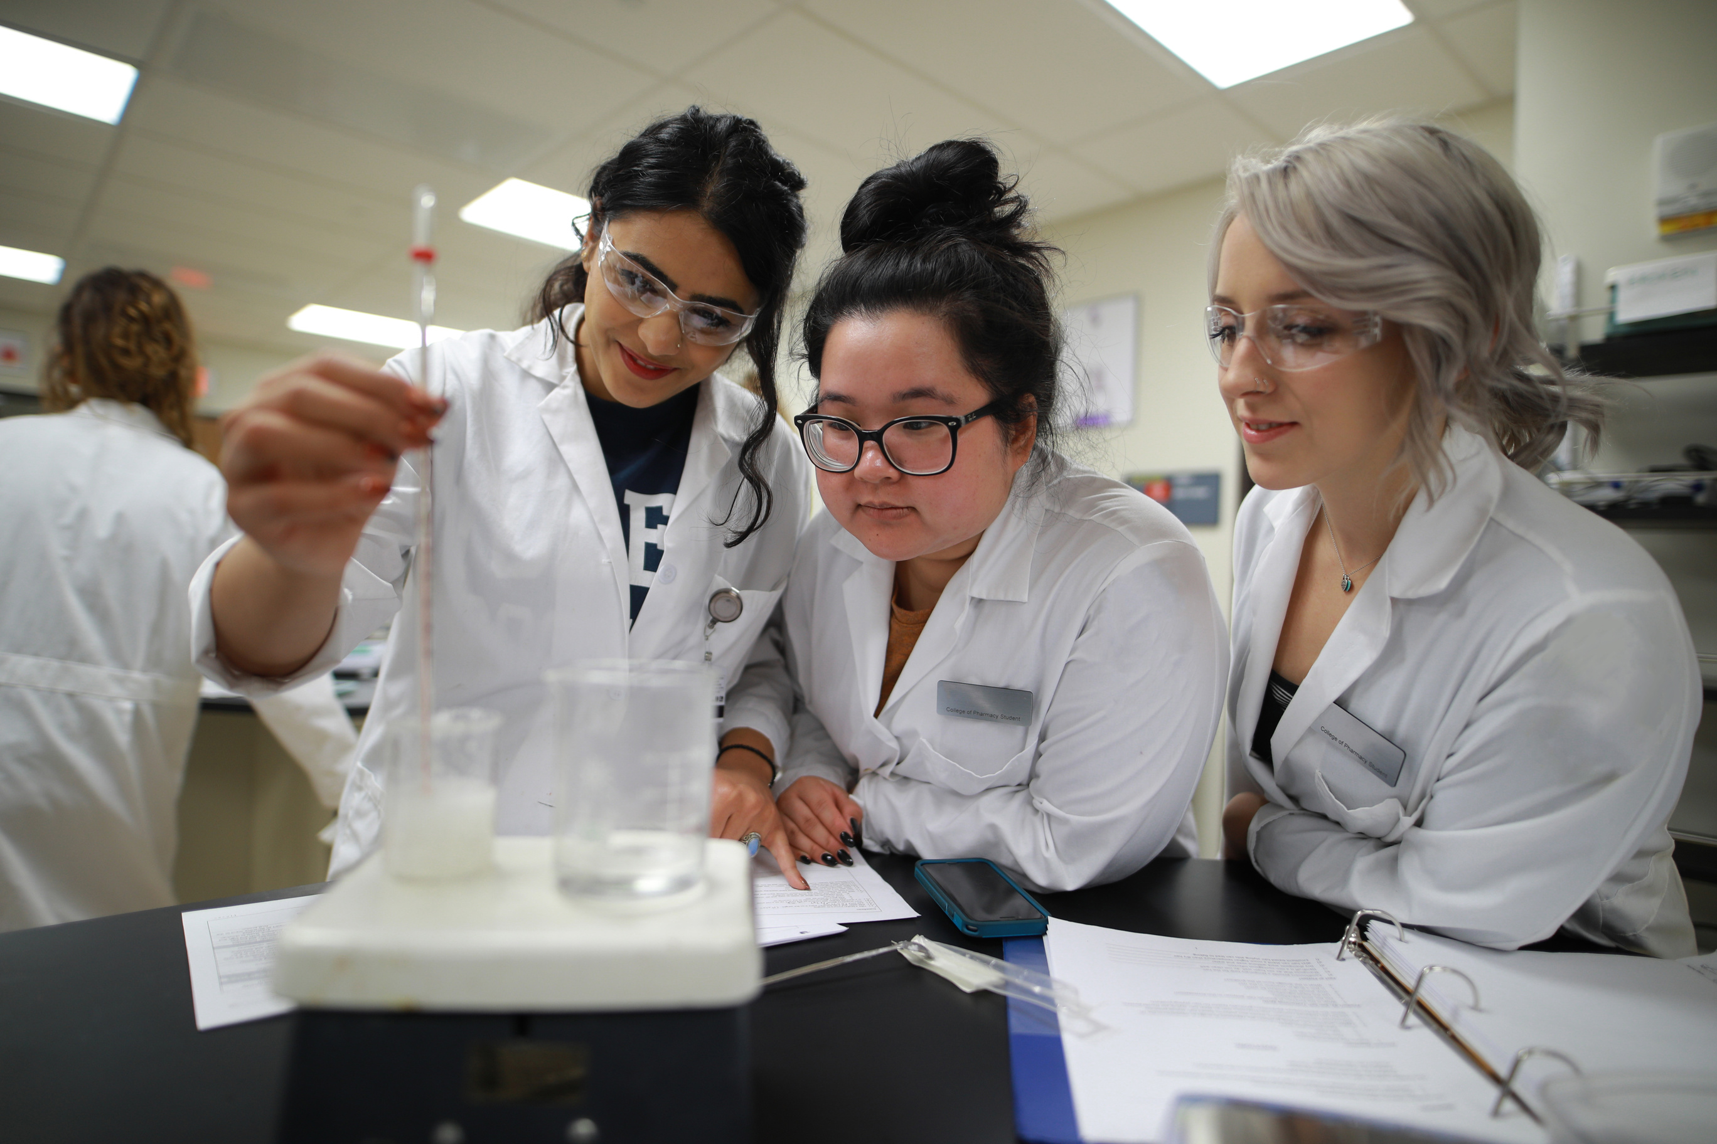
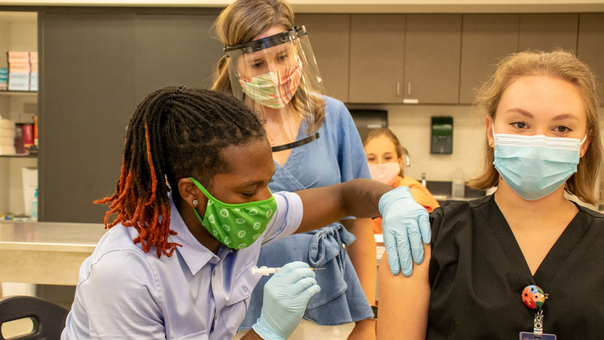










Pharmacy Is Right For You
pharmacyforme.org
@Pharm4Me

Slide 2


About Pharmacists
Pharmacists play an important role in
helping people get the best results
from their medications.
Pharmacists have duties in patient care, medication expertise and population health and pharmacy management
pharmacyforme.org
@Pharm4Me

Slide 3
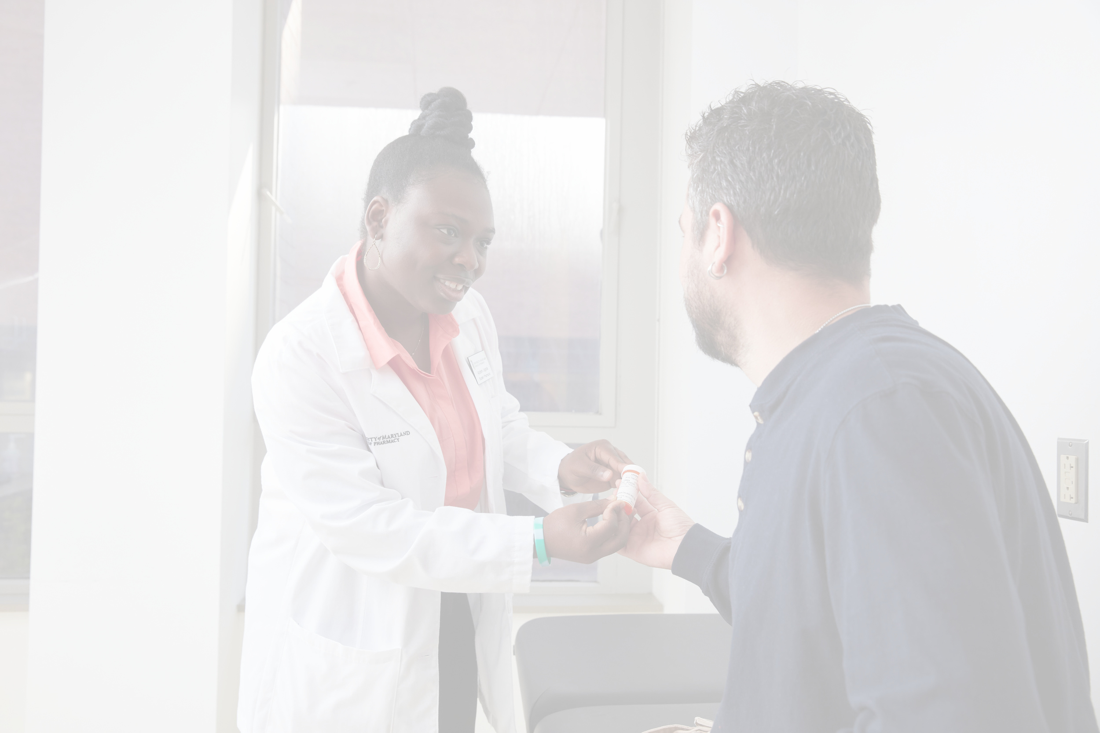
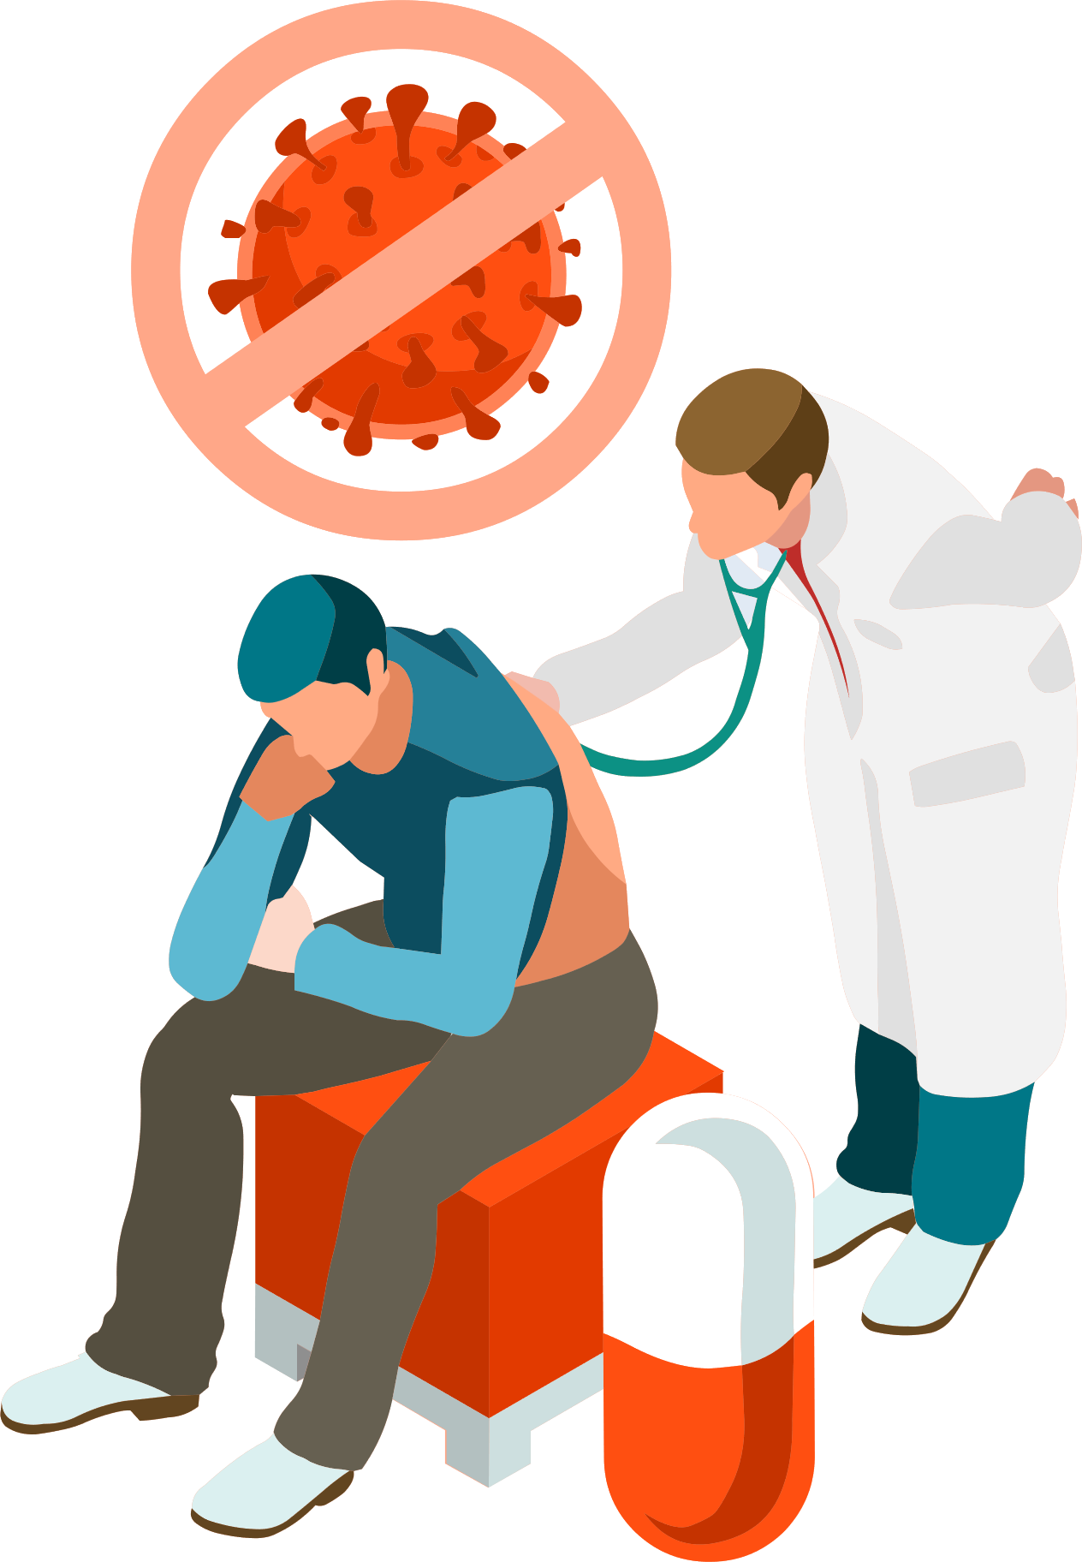
Patient Care
  Collect information about a patient’s health, social history, and medications including prescriptions
  Assess a patient’s health, medications, risk factors, health literacy, and access to medications and other care.
  Develop a medication treatment plan in collaboration with other health care professionals
  Administer immunizations
  Provide wellness services, such as smoking cessation and blood pressure monitoring.
  Counsel and educate patients
pharmacyforme.org
@Pharm4Me

Slide 4


Medication Expertise and Population Health
  Pharmacokinetics: What the body does to a drug.
  Pharmacodynamics: How drugs affect the body.
  Pharmacogenomics: How genes affect a person’s response to medications.
  Antibiotic stewardship: Promote the appropriate use of antibiotics to stop the spread of a disease in a patient or population.
pharmacyforme.org
@Pharm4Me

Slide 5

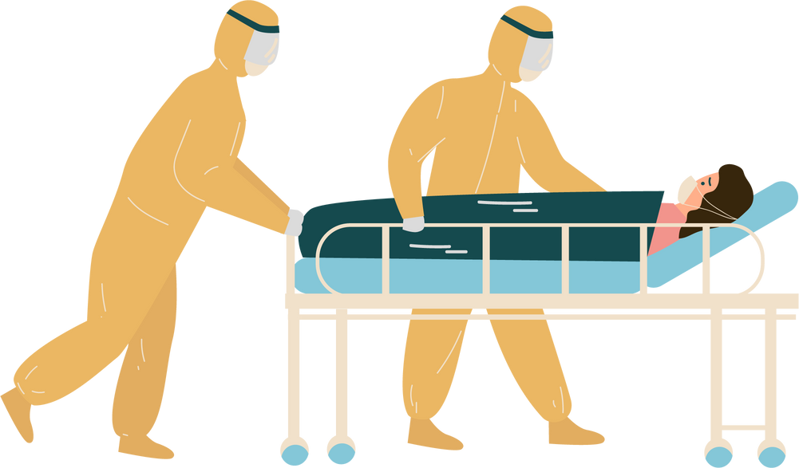
Pharmacy Management
  Develop and maintain pharmacy procedures, protocols, inventories, and disaster response plans to ensure patients have access to the right medications at the right time.
  Identify the most affordable medication options
  Teach and supervise student pharmacists and pharmacy residents to enhance their knowledge, skills, and understanding of the profession.
pharmacyforme.org
@Pharm4Me

Slide 6
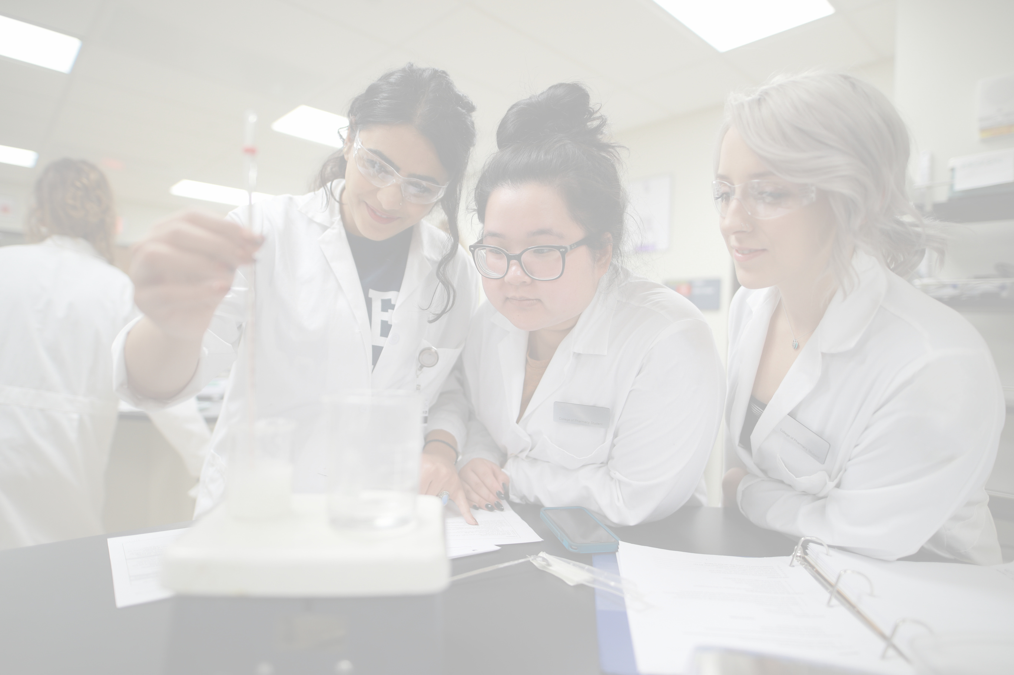

Pharmaceutical Scientists
  Work in labs or offices to develop new medicines or improve the way medicines are delivered.
  They may focus on one or more areas of research, such as:
    Biotechnology
    Drug manufacturing
    Health outcomes
    Medical technology
    Pharmacology
    Cosmetic sciences
    And more!
pharmacyforme.org
@Pharm4Me

Slide 7
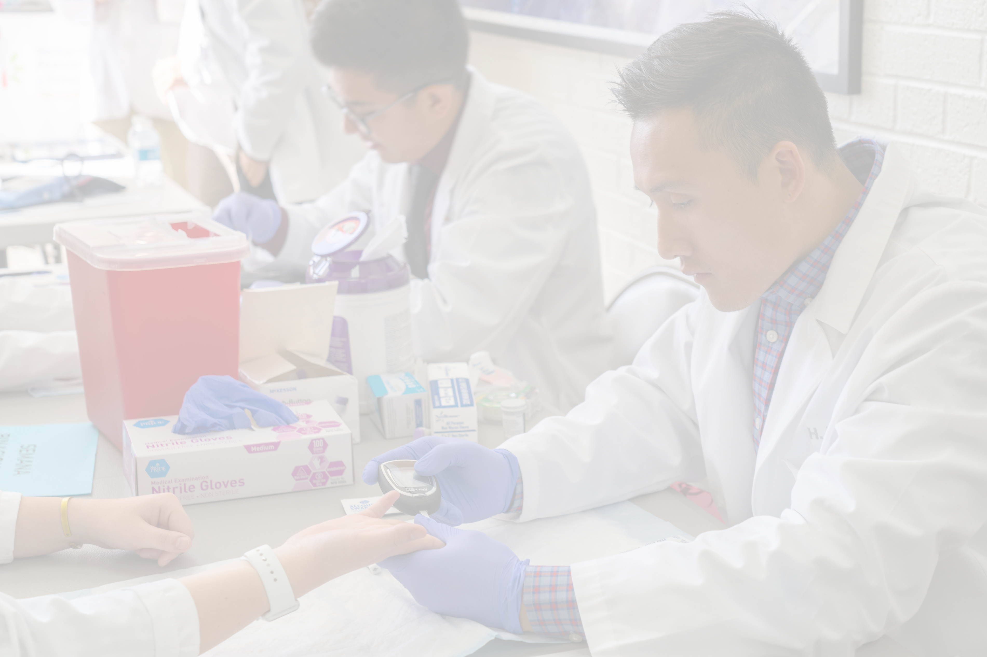









Most Trusted Profession
Ranked in the top
of Americans live within a
most trusted professions
mile radius
of a pharmacy
2022 Gallup Honesty and Ethics poll
pharmacyforme.org
@Pharm4Me

Slide 8
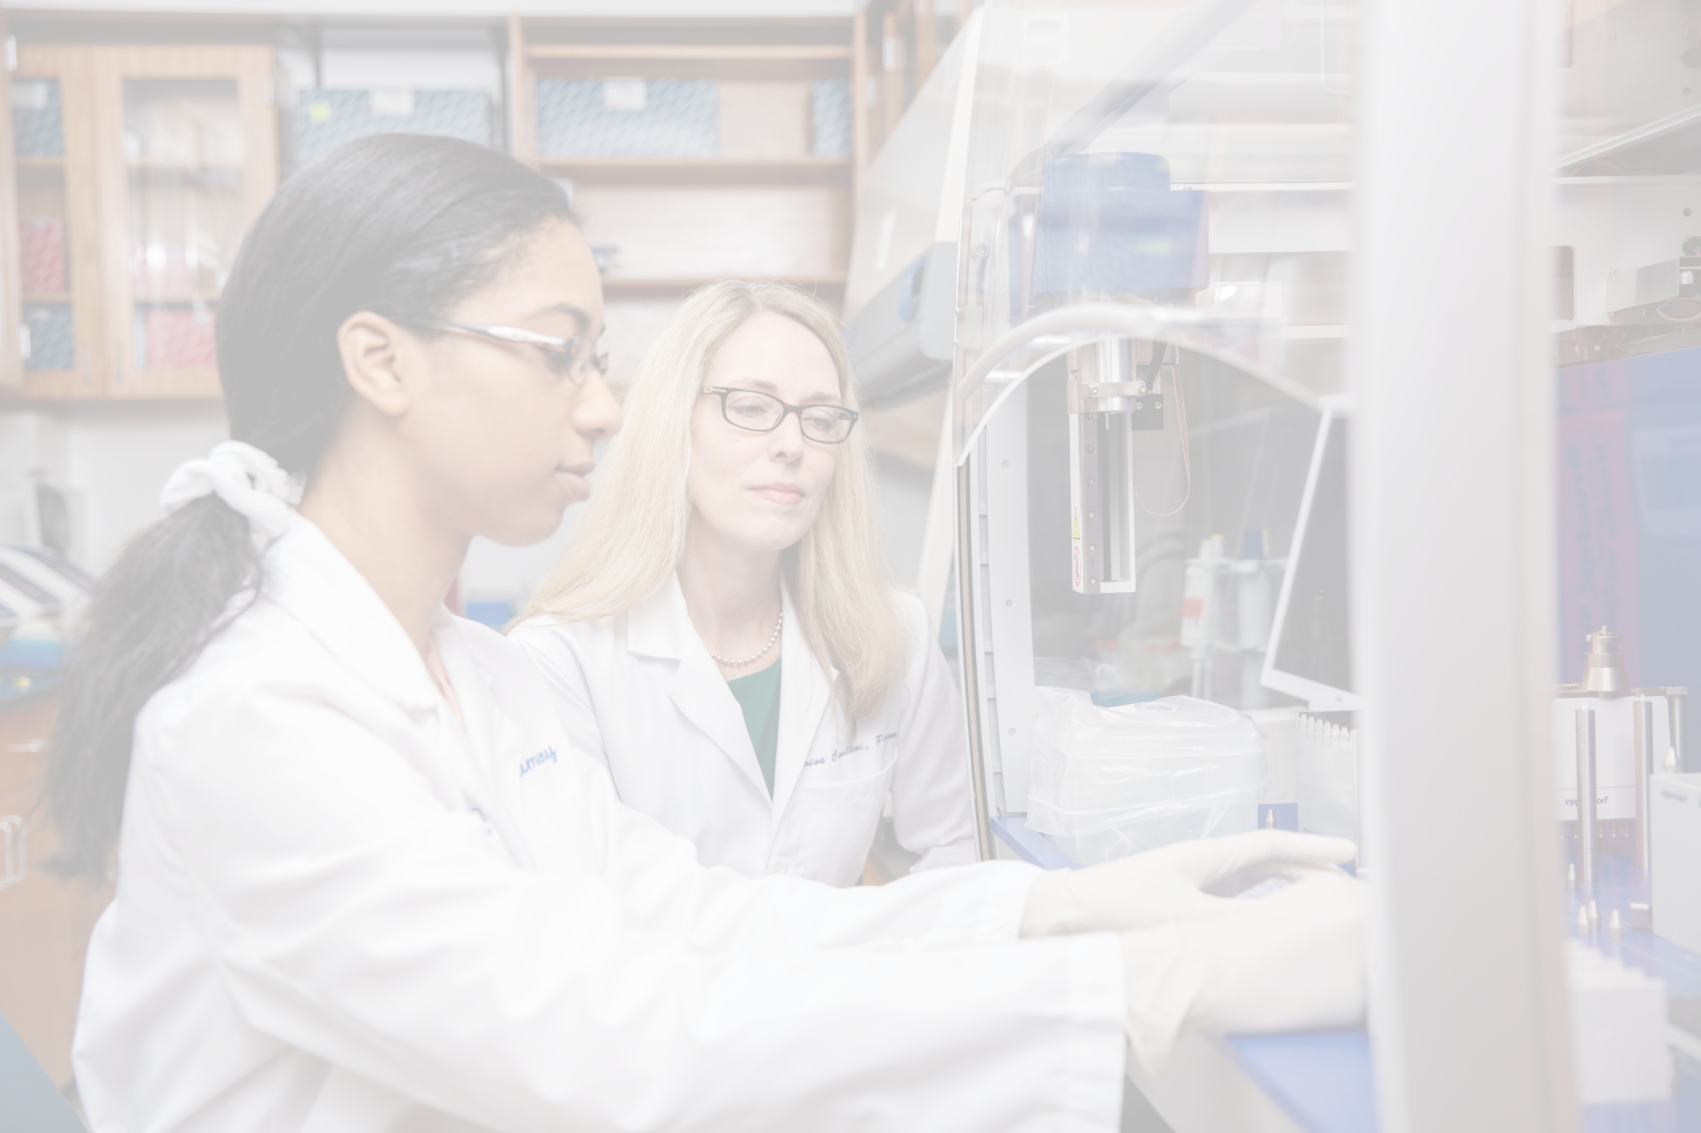

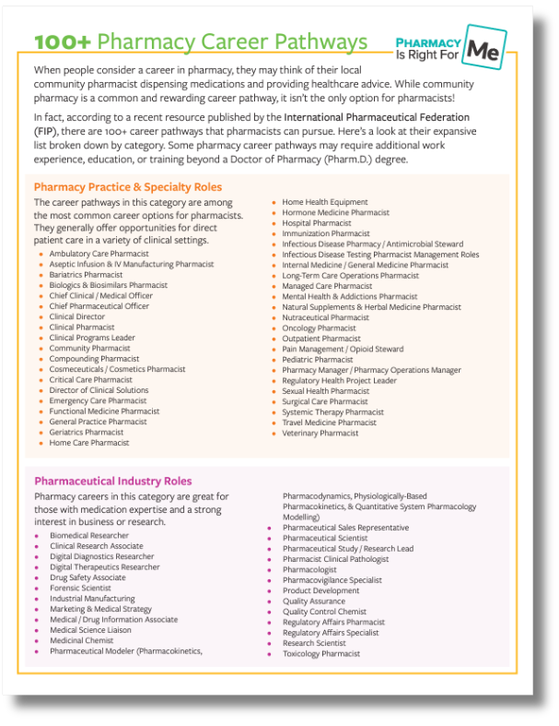


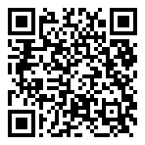


A Variety of Settings
Download it here!
career pathways
pharmacyforme.org
@Pharm4Me

Slide 9







Potential Pharmacy Careers
Dr. Brown, PharmD
Community Pharmacist
Dr. Brown, PharmD
Infectious Diseases Pharmacist
Dr. Craig, PharmD
Nuclear Pharmacist
Dr. Surowiec, Pharm D
Clinical Ambulatory Care Pharmacist
Dr. Schneiderhan, PharmD
Psychiatric Pharmacist
pharmacyforme.org
@Pharm4Me

Slide 10
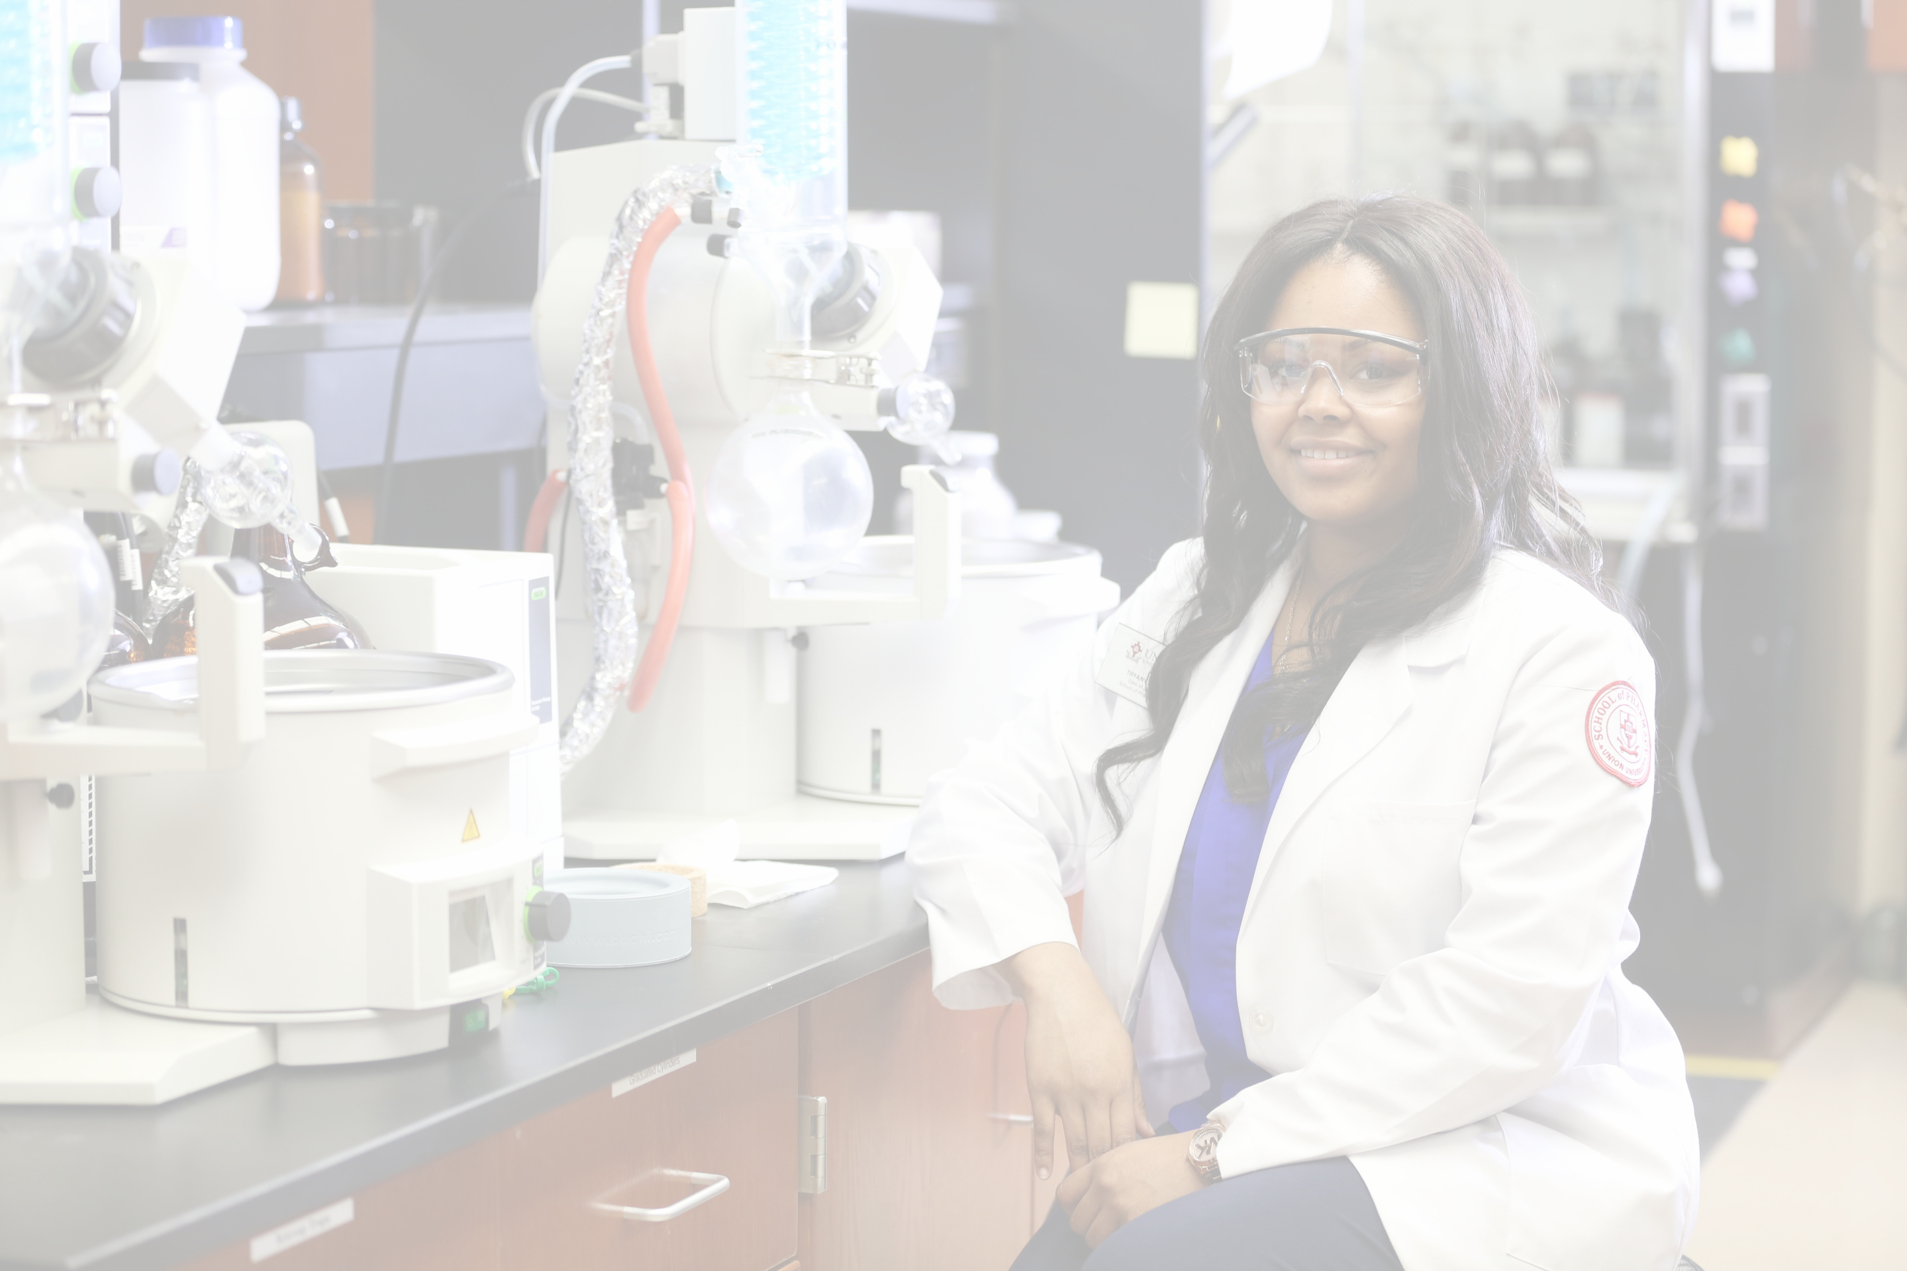

Road Map to Pharmacy
2 - 4 Years of
Pre-Pharmacy Study
3–4 Years
Pharm.D. Program
North American Pharmacist Licensure Examination (NAPLEX)
Apply using
Pharm
CAS
Optional
RESIDENCY: 1–2 years of postgraduate training focused on certain patient populations or disease states in a clinical setting.
FELLOWSHIP: Individualized postgraduate training with a focus in academia, research, or industry.
pharmacyforme.org
@Pharm4Me

Slide 11
Road Map to Pharmacy
2 - 4 Years of
Pre-Pharmacy Study
Prerequisites for admission vary by school. Specific college requirements can be found in the PharmCAS Compare Pharm.D. Programs feature but typical prerequisite courses may include:
  General Chemistry and Biology
  Physics
  Organic Chemistry
  Human Anatomy & Physiology
  Biochemistry
  Microbiology
  Calculus
  Statistics
  English Composition
  Public Speaking
  Ethics or Philosophy
  Humanities
  Behavioral & Social Science
  Economics
pharmacyforme.org
@Pharm4Me

Slide 12
Road Map to Pharmacy
3–4 Years
Pharm.D. Program
Colleges and schools of pharmacy offer the Doctor of Pharmacy (PharmD) degree program in various lengths and structures.
A few programs offer an accelerated Pharm.D. degree program to students. The “2-3” program structure includes a minimum of two-years of pre-pharmacy study followed by three-years of accelerated professional study leading to a PharmD degree. The professional curriculum is scheduled year-round, so students may complete the PharmD degree within a shorter timeframe.
Most pharmacy degree programs in the U.S. participate in the Pharmacy College Application Service (PharmCAS) for admission. Designed for first-year professional pharmacy degree applicants, PharmCAS offers a simple, efficient process to apply to multiple colleges and schools of pharmacy using a single web-based application.
The PharmCAS application opens in July for enrollment in the following year. School deadlines vary from November 1 through June 1. The PharmCAS website provides detailed information on the application process.
pharmacyforme.org
@Pharm4Me

Slide 13
Road Map to Pharmacy
North American Pharmacist Licensure Examination (NAPLEX)
To be eligible to practice as a pharmacist in the United States, individuals must pass the NAPLEX, or North American Pharmacist Licensure Examination, in addition to other state-specific licensure requirements.
It is a computer-adaptive test that provides the most precise measurement of your knowledge and ability in pharmacy.
To help you prepare for the challenge of the NAPLEX, NABP has produced a NAPLEX Candidate's Review Guide.
Practice tutorials are provided as well as a large sample of questions that reflect the type of questions which appear on the test.
pharmacyforme.org
@Pharm4Me

Slide 14
Road Map to Pharmacy
Residence and/or Fellowship
You can choose to go directly into pharmacy practice or pursue an optional residency, fellowship, specialization, or degree (i.e., MBA, PhD) to further enhance your skills and expertise.
Residency programs take two years to complete. During the first year (PGY-1), you receive more generalized training and are exposed to a broad range of clinical scenarios. During year two (PGY-2), you will focus on a specific area of interest which helps lead to specialization in that field.
A fellowship is a form of postgraduate training that is usually more research based and less clinical. A person may choose to do a fellowship in a specialty field after completing a residency so that he/she may get additional training in research in that area.
pharmacyforme.org
@Pharm4Me

Slide 15







Pharm4Me Is Here to Help!
Join Our Mailing List
Visit Pharm4Me.org
Follow @Pharm4Me
Contact Us
Gain new insights into pharmacy each month in your inbox!
Sign up at: pharmacyforme.org/pharm4me-monthly/
Learn more about all the opportunities pharmacy can offer!
Stay connected - follow @pharm4me on social media!
Email us at Pharm4Me@aacp.org!
pharmacyforme.org
@Pharm4Me

Slide 16


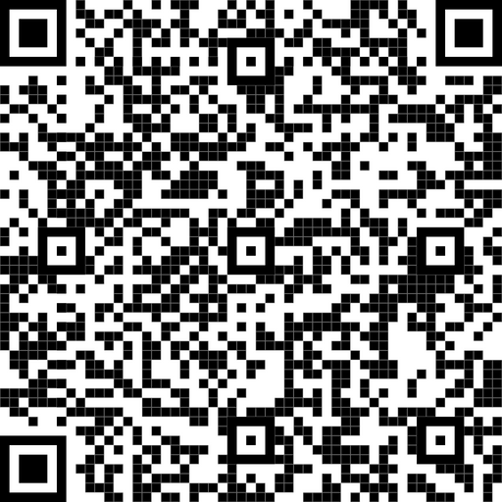
Register here!
pharmacyforme.org
@Pharm4Me

